Slide 1


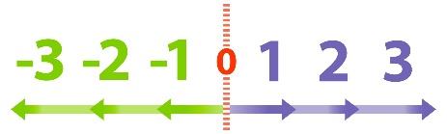
Name
Class
Tutor Group
YEAR 10 MATHEMATICS
Unit 2 Part B – Core Number Skills Types of Numbers, HCF, LCM, Prime Factorisation Laws of Indices and Standard Form Bounds and Error Intervals
KEY VOCABULARY LIST
Error interval | A range of values that a number could have taken before being rounded or truncated.
Integer | A whole number that can be positive, negative or zero.
Lower bound | The lower bound is the smallest value that would round up to the estimated value.
Rounding | To make a number simpler but keep its value close to what it was.
Upper bound | The upper bound is the smallest value that would round up to the next estimated value.
Index | The index of a number says how many times to use the number in a multiplication.
Indices | Plural form of ‘index’.
Base | The number that gets multiplied when using an index.
Standard Form | Standard form, or standard index form, is a system of writing numbers which can be particularly useful for working with very large or very small numbers. It is based on using powers of 10 to express how big or small a number is.
Notes:
ADD PAGE NUMBERS

Slide 2
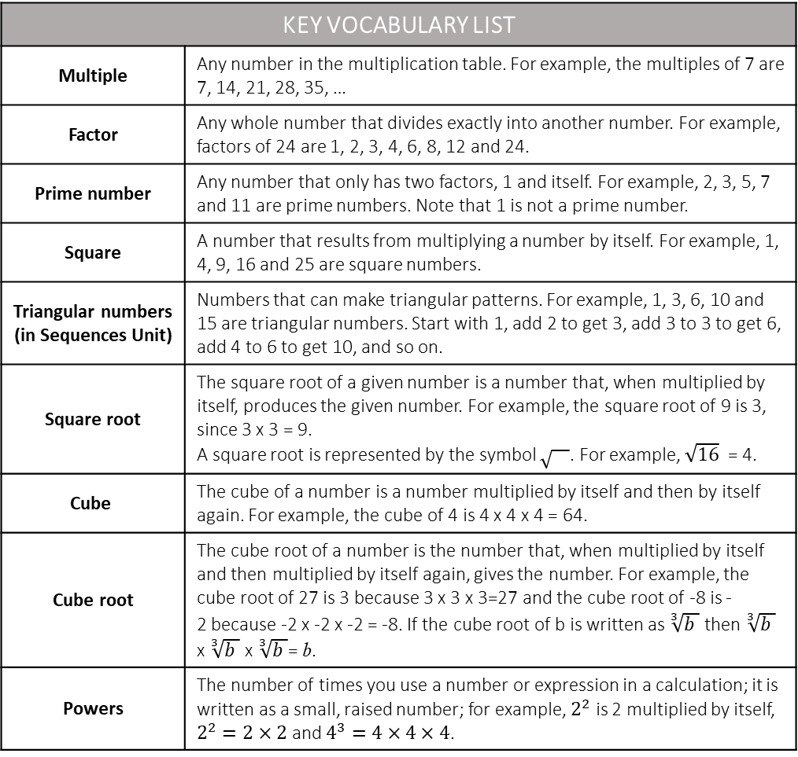
KEY VOCABULARY LIST
Multiple | Any number in the multiplication table. For example, the multiples of 7 are 7, 14, 21, 28, 35, …
Factor | Any whole number that divides exactly into another number. For example, factors of 24 are 1, 2, 3, 4, 6, 8, 12 and 24.
Prime number | Any number that only has two factors, 1 and itself. For example, 2, 3, 5, 7 and 11 are prime numbers. Note that 1 is not a prime number.
Square | A number that results from multiplying a number by itself. For example, 1, 4, 9, 16 and 25 are square numbers.
Triangular numbers (in Sequences Unit) | Numbers that can make triangular patterns. For example, 1, 3, 6, 10 and 15 are triangular numbers. Start with 1, add 2 to get 3, add 3 to 3 to get 6, add 4 to 6 to get 10, and so on.
Square root | The square root of a given number is a number that, when multiplied by itself, produces the given number. For example, the square root of 9 is 3, since 3 x 3 = 9. A square root is represented by the symbol . For example, $\sqrt{16}$ = 4.
Cube | The cube of a number is a number multiplied by itself and then by itself again. For example, the cube of 4 is 4 x 4 x 4 = 64.
Cube root | The cube root of a number is the number that, when multiplied by itself and then multiplied by itself again, gives the number. For example, the cube root of 27 is 3 because 3 x 3 x 3=27 and the cube root of -8 is -2 because -2 x -2 x -2 = -8. If the cube root of b is written as $\sqrt[3]{b }$ then $\sqrt[3]{b }$ x $\sqrt[3]{b }$ x $\sqrt[3]{b }$= b.
Powers | The number of times you use a number or expression in a calculation; it is written as a small, raised number; for example, $2^{2}$ is 2 multiplied by itself, $2^{2}=2×2$ and $4^{3}=4×4×4$.
Notes:
ADD PAGE NUMBERS

Slide 3
CONTENTS |  | Page
SUBTOPIC 1 | Multiples and Factors | 4
SUBTOPIC 2 | Lowest Common Multiples | 10
SUBTOPIC 3 | Highest Common Factors | 15
SUBTOPIC 4 | Prime Numbers and Prime Factorisation | 19
SUBTOPIC 5 | (Crossover) HCF and LCM using Prime Factorisation | 24
 | GCSE Practice Questions | 34
SUBTOPIC 6 | Squares, Cubes and Roots | 39
SUBTOPIC 7a | Positive Indices and the Laws of Indices | 46
SUBTOPIC 7b | Zero and Negative Indices | 59
 | GCSE Practice Questions | 62
SUBTOPIC 8a | (Crossover) Standard Form | 64
SUBTOPIC 8b | The Four Operations with Standard Form | 75
 | GCSE Practice Questions | 88
SUBTOPIC 9 | (Crossover) Limits of Accuracy, Bounds and Error Intervals | 90
 | GCSE Practice Questions | 104
Notes:
SPLIT UP – Check pages

Slide 4
Subtopic 1 – Multiples and Factors
LEARNING OUTCOME: To understand what multiples of whole numbers are
Objectives:
Find multiples of whole numbers.
Recognise multiples of numbers.
Look at problem solving questions.
Keywords:
Multiples
Integers
Example 1 - I do…
Example 2 - We do…
Example 3 – You do…
Steps | Write down the first five multiples of 13 | Write down the first five multiples of 8 | Write down the first five multiples of 7
1) Start with the number you are finding the multiples of. This is always the first multiple.
2) To find the next multiple, add on the number again. Keep repeating this until you have desired number of multiples.
1.
2.
Write down the first five multiples of 2.
Write down the first five multiples of 3.
List the first five common multiples of 2 and 3.
(d) Find the lowest common multiple of 2 and 3.
Write down the first five multiples of 4.
Write down the first five multiples of 5.
List the first five common multiples of 4 and 5.
(d) Find the lowest common multiple of 4 and 5.

Slide 5
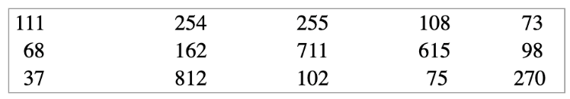
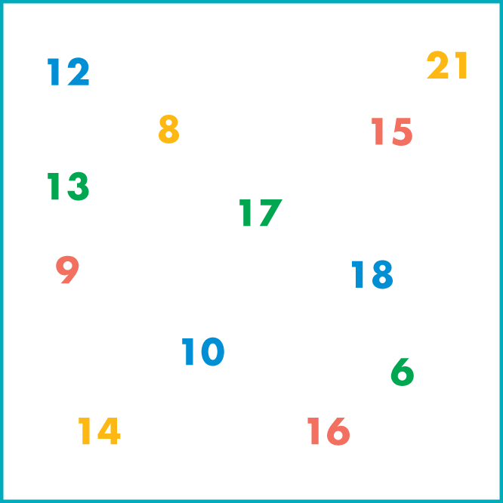

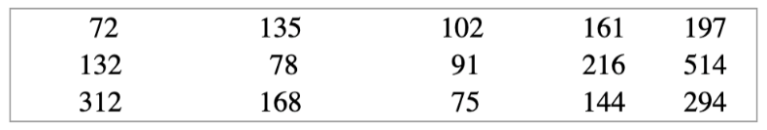
3. Write out the first five multiples of each number.
4. Write down the numbers from the box below that are multiples of:
3
7
9
11
16
2
3
5
9
5. Choose the number from the box that fits each of these descriptions (one number per description).
a multiple of 3 and a multiple of 4
a square number and an odd number
a factor of 24 and a factor of 18
a prime number and a factor of 39
an odd factor of 30 and a multiple of 3
a number with four factors and a multiple of 2 and 7
a number with five factors exactly
a triangular number and a factor of 20
an even number and a factor of 36 and a multiple of 9
a prime number that is one more than a square number
a number with factors that, when written out in order, make a number pattern in which each number is twice the one before
6. Write down the numbers from the box below that are multiples of:
7. Find the biggest number less than 100 that is a multiple of:
2
3
4
5
7
6
4
7
6
Use your calculator to help you.

Slide 6
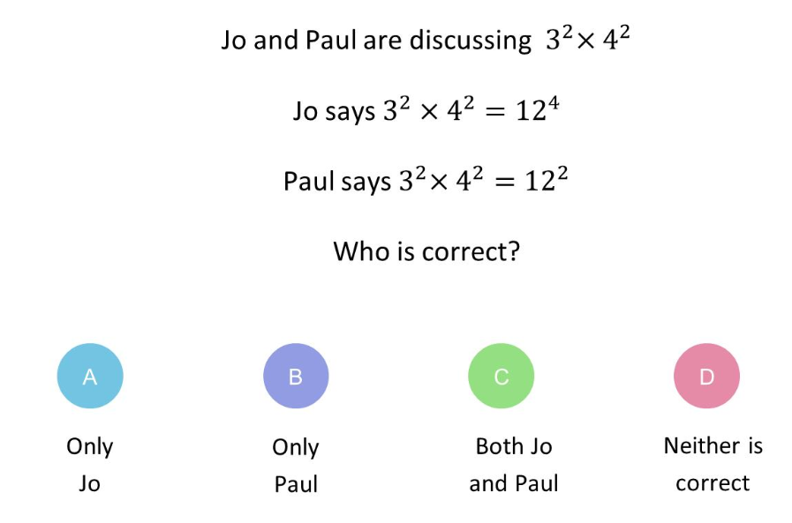
8.
Hot-dog sausages are sold in packs of 10 and hot-dog buns are sold in packs of 8. How many of each do you have to buy to have complete hot dogs with no wasted sausages or buns?
9.
A bell chimes every 6 seconds. Another bell chimes every 5 seconds. If they both chime together, how many seconds will it be before they both chime together again?
10.
Fred runs round a running track in 4 minutes. Debbie runs round in 3 minutes. If they both start together on the line at the end of the finishing straight:
When will they both be on the same line together again?
How many laps will Debbie have run?
How many laps will Fred have run?
11.
Write down the negative square root of each number.
4
49
144
1
900
Skills Check
1. Which two numbers are multiples of 6?
2. Write the first six multiples of 8
(Circle the correct answer)
7, 8
12, 18
8, 10
2, 4

Slide 7
Factors
LEARNING OUTCOME: To understand what factors of whole numbers are
Objectives:
Find factors of whole numbers.
Recognise factors of numbers.
Look at problem solving questions.
Keywords:
factors
Integers
Definition
Characteristics
Any whole number that divides exactly into another number.
Always smaller than the number, except for the number itself.
4⁶ = 4 × 4 × 4 × 4 × 4 × 4 | six lots of 4 multiplied together
6⁴ = 6 × 6 × 6 × 6 | four lots of 6 multiplied together
7³ = 7 × 7 × 7
Examples
Factor
Non - Examples
You can write a million as 1 000 000 = 10⁶.
A number multiplied by itself is the number ‘squared’. You need to know the square numbers (power 2) up to 15² = 225. How many of them can you write down from memory? You will also find it helpful to know the cubes numbers (power 3) up to 6³ = 216
The factors of 24 are 1, 2, 3, 4, 6, 8, 12 and 24.
24, 48, 72, 96 are the multiples of 24
Example 1 - I do…
Example 2 - We do…
Example 3 – You do…
Example 4- We do…
Steps | Write down the factors of 12 | Write down the factors of 18 | Write down the factors of 24 | Write down the factors of 36
Find which integer value multiply to make the value

Slide 8
1. Find the factors of each number.
a) 10 b) 28 c) 18 d) 17
e) 25 f) 40 g) 30 h) 45
i) 24 j)16
2. How many different ways can 24 chocolate bars be packed into boxes so that there are exactly the same number of bars in each box?
3. Use your calculator to find the factors of each of these numbers.
a) 120 b) 150 c) 144 d) 180
e) 169 f) 108 g) 196 h) 153

Slide 9
4.
A designer is making a box to hold 12 Christmas decorations. The decorations are to be packed in layers.
The designer wants the box to have a square base. Explain how the 12 decorations could be packed to make a square.
5.
Look at these five numbers. Use factors to explain why 32 could be the odd one out.
6.
What is the largest odd number that is a factor of 40 and a factor of 60?
Skills Check
1. Which one of the following is a factor of 16?
2. List all the factors of 32.
(Circle the correct answer)
3
6
32
4

Slide 10
Subtopic 2 – Lowest Common Multiple
LEARNING OUTCOME: To find the lowest common multiple (LCM) of a group of numbers.
Objectives:
Keywords:
Multiples
Common Multiples
Lowest Common Multiples
To understand what the LCM represents.
To find the LCM of two or more numbers.
To solve word problems using the concept of LCM
Introduction:
The lowest common multiple (LCM) is the smallest number that two (or more) numbers both divide
into evenly. Think of it as the first number that both numbers "share" when you list their multiples. The
LCM is useful when you’re adding or subtracting fractions, scheduling events, or solving problems that
involve repeated cycles or patterns.
Definition
Characteristics
The smallest integer which is a multiple of two or more positive integers.
Will be greater than or equal to the largest of the numbers.
Often abbreviated to LCM
Appears in the times table of all given numbers
Examples
Lowest Common Multiple (LCM)
Non - Examples
LCM of 8 and 12 = 24
LCM of 30 and 15 = 30
LCM of 3 and 7 = 21
LCM of 4, 5 and 6 = 60
LCM of 4 and 6 ≠ 2
LCM of 3 and 5 ≠ 1
LCM of 4 and 8 ≠ 4
Identifying the lowest common multiple of two numbers
Example 1 - I do…
Example 2 – We do…
Example 3 – You do…
Steps | Find the LCM of 3 and 7 | Find the LCM of 6 and 9 | Find the LCM of 5 and 8
1) List the first few multiples of each number. 2) Identify the multiples common to both lists, then circle the lowest common multiple. | Multiples of 3 3, 6, 9, 12, 15, 18, 21, 24, 27, 30, 33, 36, 39, 42… Multiples of 7 7, 14, 21, 28, 35, 42, 49…

Slide 11
Independent Practice
1. Find the lowest common multiple (LCM) of each of these pairs of numbers.
a) 5 and 6 | b) 2 and 7 | c) 3 and 8
d) 4 and 10 | e) 9 and 4 | f) 6 and 7
g) 25 and 35 | h) 16 and 24 | i) 20 and 28
j) 12 and 1 | k) 12 and 2 | l) 12 and 3
m) 12 and 4 | n) 12 and 5 | o) 12 and 6

Slide 12
p) 12 and 7 | q) 12 and 8 | r) 12 and 9
s) 12 and 10 | t) 12 and 11 | u) 12 and 12
v) 12 and 14 | w) 12 and 16 | x) 12 and 17
y) 12 and 40 | z) 12 and 50 | aa) 12 and 60
a) 6 and 12 | b) 3 and 8 | c) 6 and 14
d) 6 and 4 | e) 12 and 2 | f) 24 and 12

Slide 13
4. Answer the following questions:
a) Cara is buying nuts and bolts at a store. The store sells nuts in packs of 5 and bolts in packs of 10. If Cara wishes to buy the same number of nuts and bolts, what is the smallest number of nuts that she can buy?
b) A white light flashes every 28 seconds. A red light flashes every 7 seconds. They both flash at the same time. After how many seconds will they next both flash at the same time?
c) Buses to London leaves Norwich station every 30 minutes. Buses heading to Manchester leaves Norwich station every 20 minutes. At 10am a bus to London and a bus to Manchester both leave at the same time. Work out the next time that both buses leave at the same time.
d) A bus leaves Antrim Bus Station every 12 minutes. A train leaves Antrim Train Station every 18 minutes. At 8m a bus and a train leave the stations at the same time.
i) When is the next time that a bus and a train leave at the same time?
ii) Between 8am and 11am (inclusive), on how many occasions does a bus and a train leave at the same time?

Slide 14
5. Answer the following questions, the first one may be done as an example:
a) A red light flashes every 3 seconds. A yellow light flashes every 8 seconds. A green light flashes every 11 seconds They all flash at the same time. After how many seconds will they next all flash at the same time?
b) Light A flashes every 5 seconds. Light B flashes every 6 seconds. Light C flashes every 7 seconds. All three lights flash at the same time. Work out how long it will take for all three lights to flash at the same time again.
c) Robert, John and Paul start to run from the same point, in the same direction, around a circular track. If they take 126 seconds, 154 seconds and 198 seconds respectively to complete one round along the track, when will they next meet again at the starting point?
d) Three boys regularly visit the city centre in the morning. Paul goes every thirteen days, Peter goes every four days and Philip goes every two days. If they all visit the city on 1st January 2023, how many more times in 2023 will they all be in the city centre on the same morning?

Slide 15
Subtopic 3 – Highest Common Factor
LEARNING OUTCOME: To understand and be able to list the common factors of a number, identifying the highest common factor
Objectives:
Keywords:
Factor
Highest Common Factor
To understand the concept of highest common factor.
To be able to recognise common factors and identify the highest.
To be able to apply the concept of highest common factors in problem solving.
Introduction – Read and annotate:
The highest common factor (HCF), is the biggest number that can divide two (or more) numbers
evenly, with no remainder. Think of it as the largest number that both numbers "share" as a factor. The
HCF is useful for simplifying fractions, dividing things into equal parts, and finding the biggest group
that something can be split into evenly.
Definition
Characteristics
The largest integer which is a factor of two or more given positive integers.
Will be less than or equal to the smallest of the given numbers.
Often abbreviated to HCF
Examples
Highest common factor
Non - Examples
HCF of 8 and 12 = 4
HCF of 30 and 15 = 15
HCF of 4 and 15 = 1
LCM of 4, 6 and 10 = 2
HCF of 1 and 2 ≠ 2
HCF of 4 and 8 ≠ 8
HCF of 4 and 5 ≠ 20
Calculating the highest common factor of two numbers
Example 1 - I do…
Example 2 – We do…
Example 3 – You do…
Steps | Find the HCF of 10 and 15 | Find the HCF of 16 and 24 | Find the HCF of 12 and 18
1) List all the factors of each number. 2) Identify the factors common to both lists, then circle the highest common factor. | Factors of 10 1, 2, 5, 10 Factors of 15 1, 3, 5, 15

Slide 16
Independent Practice
1. Work out the highest common factor of the following pairs of numbers:
a) 4 and 14 | b) 6 and 14 | c) 6 and 9
d) 9 and 21 | e) 6 and 15 | f) 10 and 17
g) 30 and 45 | h) 40 and 60 | i) 28 and 63
j) 24 and 36 | k) 16 and 28 | l) 18 and 45
m) 150 and 200 | n) 12 and 54 | o) 90 and 270
p) 39 and 65 | q) 12 and 1 | r) 12 and 2
s) 12 and 3 | t) 12 and 4 | u) 12 and 5

Slide 17
2. Answer the following questions:
a) A PE teacher has to organise two year groups into netball teams, each separately. Year 7 has 70 students and Year 8 has 98 students. If each year group must be split equally into teams of all the same size, what is the largest team size she can use?
b) Alannah has two lengths of ribbon. One length of ribbon is 36cm long and the other length is 45cm long. Alannah wants to cut lengths of ribbon into shorter lengths that are of equal length. Alannah does not want any ribbon left over. What is the longest possible length for each of the shorter lengths of ribbon?
c) Helen thinks of two numbers. The highest common factor of her two numbers is 5. The lowest common multiple of her two numbers is a multiple of 12. Write down two possible numbers that Helen could be thinking of.
d) Lenny wants to cut identical squares, as big as he can, from a piece of paper measuring 168mm by 196mm. What is the length of each square?

Slide 18
e) Olivia thinks of two numbers. The LCM of the two numbers is 36. The HCF of the two numbers is 3. Both numbers are less than 5. Write down two possible numbers that Olivia could be thinking of.
f) Niamh thinks of a number. The HCF of the two numbers is 8. The lowest common multiple of the two numbers is a multiple of 5. Write down two possible numbers Niamh could be thinking of.
g) Here are some properties of a number: It is a common factor of 288 and 360. It is a common multiple of 4 and 6. It is larger than 25. Find the two possible numbers with these properties.
h) Kenny is thinking of two numbers greater than 10. He says: ”The highest common factor (HCF) of my two numbers is 7. The lowest common multiple (LCM) of my two numbers is 84” Write down the two numbers that Kenny is thinking of.

Slide 19
Subtopic 4 – Prime Numbers and Prime Factor Decomposition
LEARNING OUTCOME: To understand what prime numbers are and how to find LCM & HCF
Objectives:
Keywords:
factor tree
highest common factor (HCF)
index notation
lowest common multiple (LCM)
prime factor
prime factorisation
product of prime factors
unique factorisation theorem
Identify prime numbers and what Prime factors are.
identify the lowest common multiple (LCM) of two numbers.
identify the highest common factor (HCF) of two numbers.
Definition
Characteristics
Any integer that has two distinct factors, 1 and itself.
The factors are 1 and the number itself. It cannot be made by multiplying any other integers.
4⁶ = 4 × 4 × 4 × 4 × 4 × 4 | six lots of 4 multiplied together
6⁴ = 6 × 6 × 6 × 6 | four lots of 6 multiplied together
7³ = 7 × 7 × 7
Examples
Prime Number
Non - Examples
2, 3, 5, 7 and 11 are prime numbers.
Note that 1 is not a prime number.
You can write a million as 1 000 000 = 10⁶.
A number multiplied by itself is the number ‘squared’. You need to know the square numbers (power 2) up to 15² = 225. How many of them can you write down from memory? You will also find it helpful to know the cubes numbers (power 3) up to 6³ = 216
Example 1 - I do…
Example 2 - We do…
Example 3 – You do…
Steps | Write down all the prime numbers between 30 and 40 | Write down all the prime numbers between 40 and 50 | Write down all the prime numbers between 20 and 30
A prime number has exactly two distinct factors which are 1 and the number itself.
1. There is only one only prime number between 90 and 100. Write it down.
2. Use the rules for recognising multiples to decide which of these numbers are not prime numbers.
3.
When three different prime numbers are multiplied together, the answer is 105.
What are the three prime numbers?
19

Slide 20
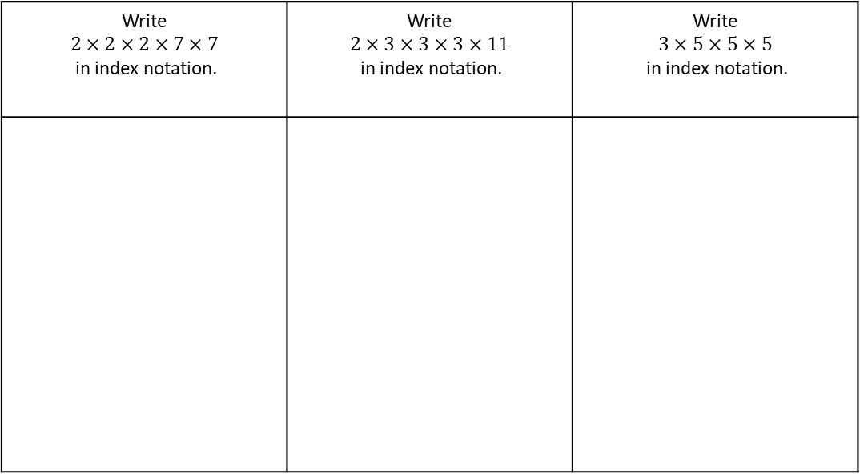


The unique factorisation theorem states that every integer greater than 1 is either a prime number or can be written as the product of prime numbers. This gives the prime factors of the number.
Consider 110. Find two numbers that, when multiplied together, give that number, for example, 2 x 55. Are they both prime? No, 55 isn’t. So take 55 and repeat the operation, to get 5 x 11. Are these both prime? Yes, so:
110 = 2 x 5 x 11
The prime factors of 110 are 2, 5 and 11 and 110 can be written in ‘prime factorized’ form as 2 x 5 x 11
Example 4 - I do…
Example 5 - We do…
Example 6 – You do…
Write $$2×2×2×7×7$$ in index notation. | Write $$2×3×3×3×11$$ in index notation. | Write $$3×5×5×5$$ in index notation.
4. Write each of these in index notation.
5. Write each of these in index notation.
$8×8×8$
$3×3×3×3×3$
$7×7×9$
$4×4×6×6$
$2×2×11×11×11$
$8×8×8×2×2×3$
$3×5×4×2×3$
$7×7×9×12×7×6$
$3×3×3×4×4×6×6$
$5×5×13×5×13×37$

Slide 21


Write the following numbers as products of primes using index notation:
Example 7 - I do…
Example 8 - We do…
Example 9 – You do…
Steps | 24 | 16 | 18
Write down the number that is being decomposed at the top.
Draw 2 lines from the number and think of two factors of the number above which are prime
Draw 2 lines from the factor which was not prime and think of two factors of that new number where one is prime (keep repeating this step until you are left with prime numbers)
Circle all prime number
Write all prime numbers as a multiplication, then put into index notation.
24
2
12
2
6
2
3
$$24=$$
$$24=$$
6. Fill in the table
Q | Number | Prime Factor Decomposition | Index Form
a) | 8
b) | 12
c) | 20
Notes:
You do needed

Slide 22
Q | Number | Prime Factor Decomposition | Index Form
d) | 9
e) | 30
f) | 36
g) | 42
h) | 56
i) | 72

Slide 23
Q | Number | Prime Factor Decomposition | Index Form
j) | 32
k) | 48
l) | 60
m) | 120
n) | 150
p) | 200

Slide 24
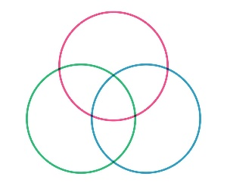
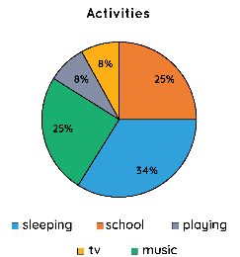
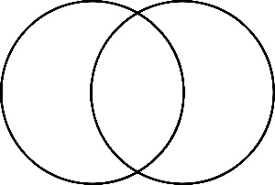
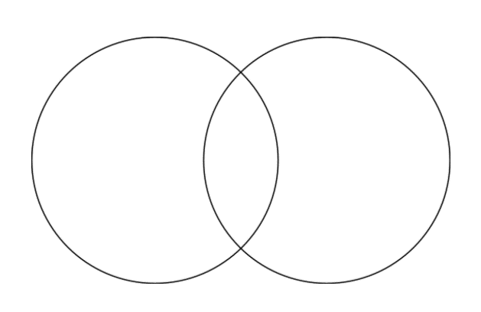
Subtopic 5 (Crossover) – HCF and LCM with Prime Decomposition
Learning outcome: To use prime decomposition to find the HCF and LCM
Objectives:
Keywords:
Prime decomposition
Common factor
Venn Diagram
To find the prime decomposition of numbers
To identify common factors and put these in Venn Diagrams
To use these Venn Diagrams to find the HCF and LCM
Introduction – Read and annotate:
This subtopic combines your existing knowledge of HCF and LCM with prime factor decomposition. You
will learn how to use Venn diagrams to calculate the HCF and LCM.
Definition
Characteristics
A Venn diagram is a diagram that uses overlapping circles to show the relationship between two or more sets.
Each circle represents one set
The intersection represents the common
elements of sets
Venn Diagram
Examples
4⁶ = 4 × 4 × 4 × 4 × 4 × 4 | six lots of 4 multiplied together
6⁴ = 6 × 6 × 6 × 6 | four lots of 6 multiplied together
7³ = 7 × 7 × 7
Non - Examples
Using Venns
Find the prime factor decomposition of the following numbers, and put these into the Venn Diagrams
Example 1 - I do…
Steps | 30 and 45
Find the product of primes for both numbers using factor trees.
Write the product of primes for both numbers.
Place the common primes in the intersection and any others in the individual circle.
30 45
Example 2 - We do…
Steps | 24 and 40
Find the product of primes for both numbers using factor trees.
Write the product of primes for both numbers.
Place the common primes in the intersection and any others in the individual circle.
24 40

Slide 25
Example 3 - You do…
Steps | 28 and 60
Find the product of primes for both numbers using factor trees.
Write the product of primes for both numbers.
Place the common primes in the intersection and any others in the individual circle.
28 60
Independent Practice
1. Find the prime factor decomposition of the following numbers, and put these into the Venn Diagrams
a) 40 and 50
b) 36 and 45
c) 18 and 24
d) 28 and 42

Slide 26
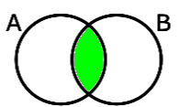
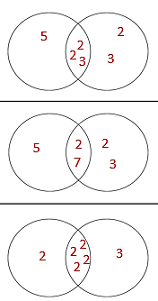
As you already know, the HCF (highest common factor) is the largest factor of two numbers.
Up until now, we have had to list all the factors of each number, and then looked through to find common factors. This works well for small numbers, but large numbers with lots of factors can make this process very difficult.
We have used Venn diagrams to organise the prime factors. It is useful to do this to help us find the HCF and LCM of two or more numbers.
The HCF can be found in the intersection of the two numbers:
To find the HCF we multiply the numbers in the intersection.
Highest Common Factor
 | Example 4 – I do… | Example 5 – We do… | Example 6 – You do…
Steps | Find the HCF of 60 and 72 using the given Venn diagram | Find the HCF of 70 and 84 using the given Venn diagram | Find the HCF of 32 and 48 using the given Venn diagram
1) Highlight the intersection of the Venn Diagram 2) Multiply the numbers in the intersection to find the HCF
60 72 70 84 32 48
Independent Practice
2. Calculate the Highest Common Factor of the following pairs of numbers.
a) 45 and 75
b) 28 and 35
45 75
28 35
3
3
5
2
7
5
5
2
c) 12 and 72
d) 36 and 52
12 72
36 52
2
2
2
3
3
2
2
13
3
3

Slide 27
Find the Highest Common Factor of the following pairs of numbers.
Example 7 - I do…
Steps | 30 and 45
Find the product of primes for both numbers using factor tress.
Write the product of primes for both numbers.
Place the integers in both products of primes in the intersection and any spare in the individual circle.
Multiply the numbers in the INTERSECTION (middle) together
Solve the calculation to give the highest common factor.
30 45
Example 8 - We do…
Steps | 24 and 40
Find the product of primes for both numbers using factor tress.
Write the product of primes for both numbers.
Place the integers in both products of primes in the intersection and any spare in the individual circle.
Multiply the numbers in the INTERSECTION (middle) together
Solve the calculation to give the highest common factor.
24
40
Example 9 – You do…
Steps | 28 and 60
Find the product of primes for both numbers using factor tress.
Write the product of primes for both numbers.
Place the integers in both products of primes in the intersection and any spare in the individual circle.
Multiply the numbers in the INTERSECTION (middle) together
Solve the calculation to give the highest common factor.
28
60
Notes:
Venn Diagram method

Slide 28
Independent Practice
3. Calculate the Highest Common Factor of the following pairs of numbers.
a) 40 and 50
b) 36 and 45
c) 18 and 24
d) 28 and 42
e) 60 and 72
f) 70 and 84

Slide 29
g) 32 and 48
h) 27 and 54
i) 64 and 100
j) 144 and 180
k) 72 and 108
l) 144 and 168

Slide 30
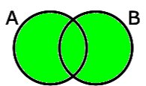
Finding the LCM by Prime Factorisation
In a similar way, we can also use Venn diagrams to find the LCM of two or more numbers.
The LCM can be found in the union of the two numbers:
To find the LCM we multiply the numbers in the union.
 | Example 10 – I do… | Example 11 – We do… | Example 12 – You do…
Steps | Find the HCF of 60 and 72 using the given Venn diagram | Find the HCF of 70 and 84 using the given Venn diagram | Find the HCF of 32 and 48 using the given Venn diagram
1) Highlight the intersection of the Venn Diagram 2) Multiply the numbers in the intersection to find the HCF
60 72 70 84 32 48
Independent Practice
6. Calculate the Highest Common Factor of the following pairs of numbers.
a) 45 and 75
b) 28 and 35
45 75
28 35
3
3
5
2
7
5
5
2
c) 12 and 72
d) 36 and 52
12 72
36 52
2
2
2
3
3
2
2
13
3
3

Slide 31
Lowest Common Multiple
Example 13 - I do…
Find Lowest Common Multiple of the following pairs of numbers.
Steps | 18 and 45
Find the product of primes for both numbers using factor tress.
Write the product of primes for both numbers.
Place the integers in both products of primes in the intersection and any spare in the individual circle.
Multiply ALL numbers in the Venn together
Solve the calculation to give the lowest common multiple.
18
45
3
Example 14 - We do…
Steps | 24 and 40
Find the product of primes for both numbers using factor tress.
Write the product of primes for both numbers.
Place the integers in both products of primes in the intersection and any spare in the individual circle.
Multiply ALL numbers in the Venn together
Solve the calculation to give the lowest common multiple.
24
40
Example 15 – You do…
Steps | 28 and 60
Find the product of primes for both numbers using factor tress.
Write the product of primes for both numbers.
Place the integers in both products of primes in the intersection and any spare in the individual circle.
Multiply ALL numbers in the Venn together
Solve the calculation to give the lowest common multiple.
28
60
31
Notes:
Venn Diagram method

Slide 32
Independent Practice
7. Calculate the Lowest Common Multiple of the following pairs of numbers.
a) 40 and 50
b) 36 and 45
c) 18 and 24
d) 28 and 42
e) 60 and 72
f) 70 and 84

Slide 33
g) 32 and 48
h) 27 and 54
i) 64 and 100
j) 144 and 180
k) 72 and 108
l) 144 and 168

Slide 34
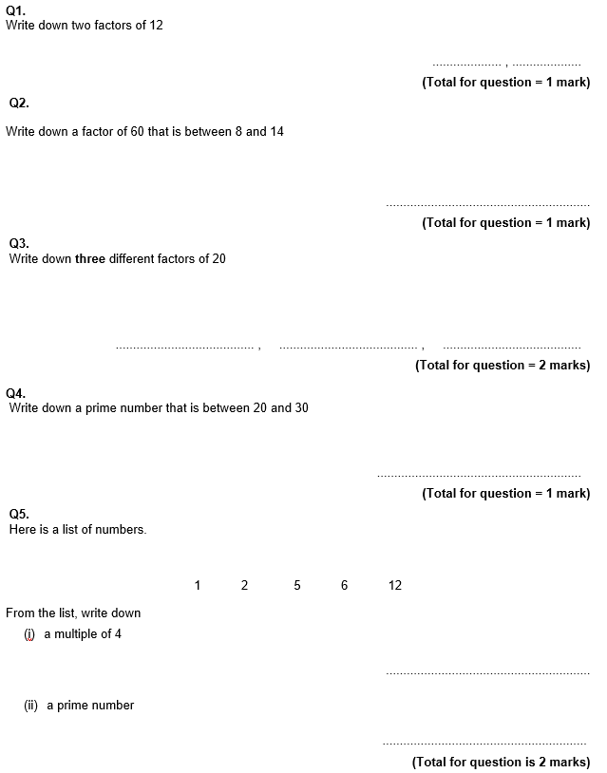
GCSE Past Paper Questions

Slide 35
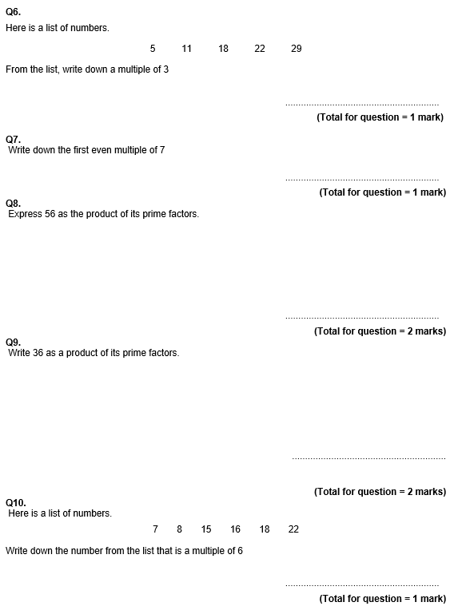

Slide 36
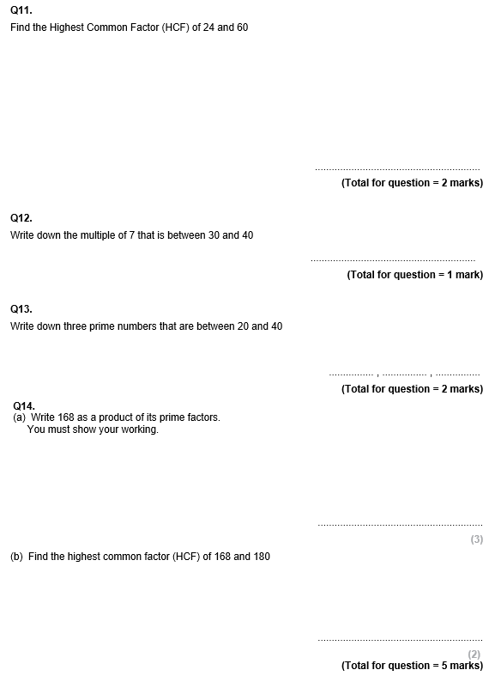

Slide 37
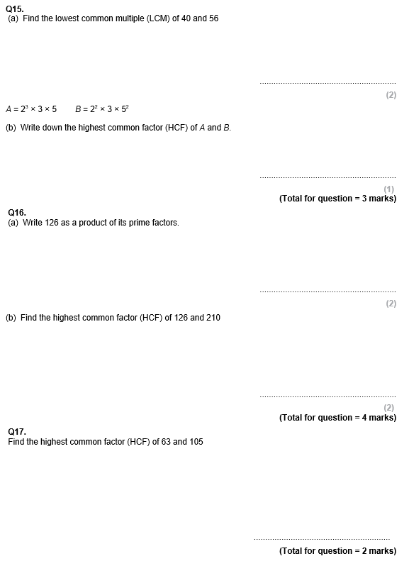

Slide 38
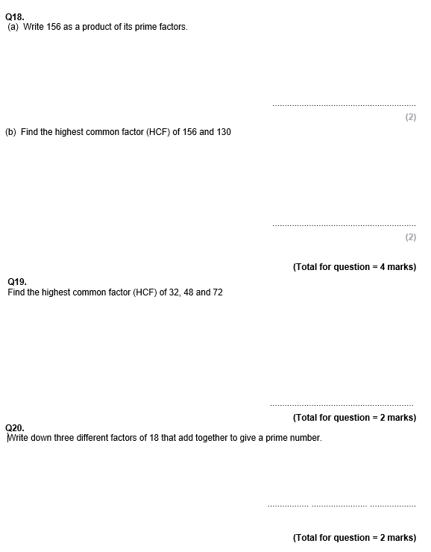

Slide 39

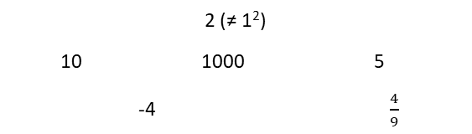
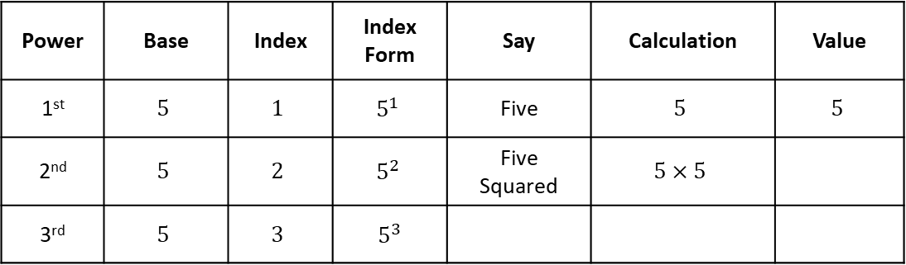
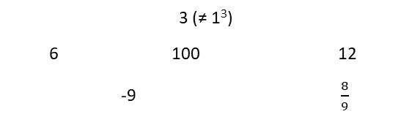
Subtopic 6 – Squares, Cubes and Roots
LEARNING OUTCOME: To understand square and cube numbers
Objectives:
To be able to recall the square numbers up to 15 squared
To be able to recall the cube numbers up to 10 cubed.
Keywords:
- Square
- Cube
Introduction:
Squares numbers and and cube numbers are ways of multiplying a number by itself a certain number of
times, creating what we call powers. When you square a number, you multiply it by itself. Cubing a
number means multiplying it by itself and then multiplying by itself again. Knowing how to work with
squares and cubes is an important skill, as it forms the foundation for understanding powers,
exponents and roots.
Definition
Characteristics
The process of creating a square number is called “squaring” and is shown using an index of 2
An integer multiplied by itself makes a square number
Examples
Square number
Non - Examples
2 (≠ 1²)
10 1000 5
-4 $\frac{4}{9}$
4 (= 2²) 9 (= 3²) 100 (= 10²)
484 (=22²) 1 (= 1²) 10 000 (= 100²)
Definition
Characteristics
The process of creating a cube number is called “cubing” and is shown using an index of 3
An integer multiplied by itself and then itself again makes a cube number
3
Examples
Cube number
Non - Examples
3 (≠ 1³)
6 100 12
-9 $\frac{8}{9}$
8 (= 2³) 27 (= 3³) 1000 (= 10³)
10 648 (=22³) 1 (= 1³) 1 000 000 (= 100³)
Index form and language
Example 1 - I do…
Power | Base | Index | Index Form | Say | Calculation | Value
1st | $$5$$ | $$1$$ | $$5^{1}$$ | Five | $$5$$ | $$5$$
2nd | $$5$$ | $$2$$ | $$5^{2}$$ | Five Squared | $$5×5$$
3rd | $$5$$ | $$3$$ | $5^{3}$

Slide 40
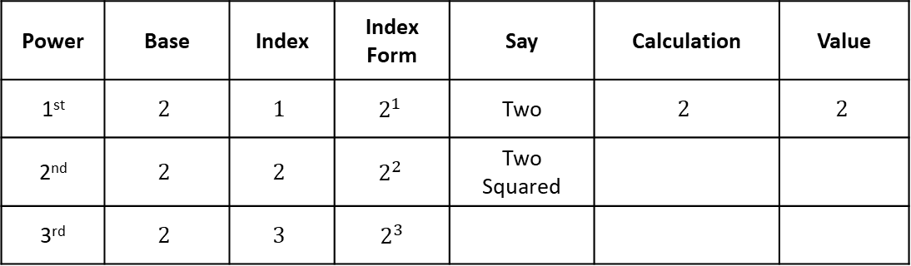
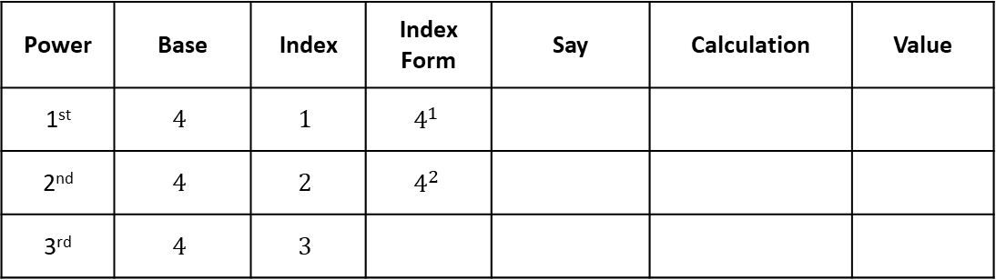
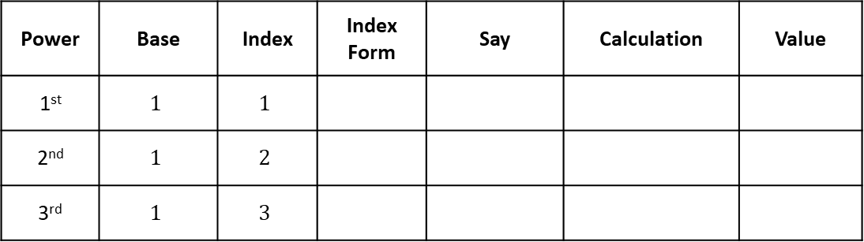
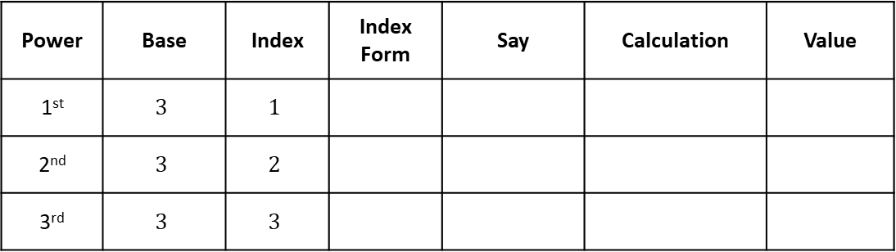
Example 2 – We do…
Power | Base | Index | Index Form | Say | Calculation | Value
1st | $$2$$ | $$1$$ | $$2^{1}$$ | Two | $$2$$ | $$2$$
2nd | $$2$$ | $$2$$ | $$2^{2}$$ | Two Squared
3rd | $$2$$ | $$3$$ | $2^{3}$
Example 3 – You do…
Power | Base | Index | Index Form | Say | Calculation | Value
1st | $$4$$ | $$1$$ | $$4^{1}$$
2nd | $$4$$ | $$2$$ | $$4^{2}$$
3rd | $$4$$ | $$3$$
Independent Practice
1. Fill in the blanks
a)
Power | Base | Index | Index Form | Say | Calculation | Value
1st | $$3$$ | $$1$$
2nd | $$3$$ | $$2$$
3rd | $$3$$ | $$3$$
b)
Power | Base | Index | Index Form | Say | Calculation | Value
1st | $$1$$ | $$1$$
2nd | $$1$$ | $$2$$
3rd | $$1$$ | $$3$$

Slide 41






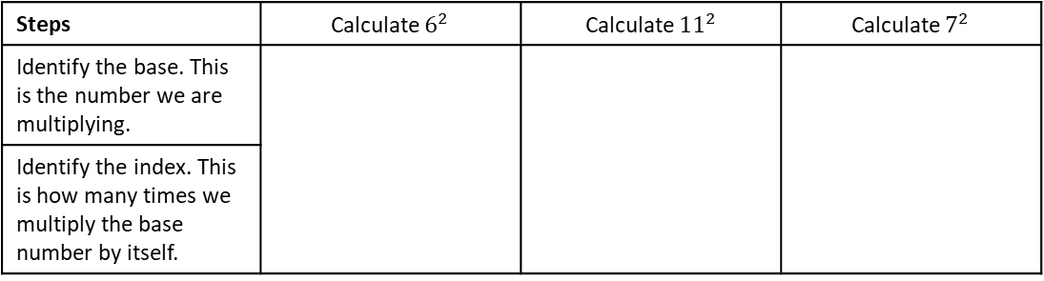










To be able to recall the square numbers up to 15 squared
Example 4 - I do…
Example 5 – We do…
Example 6 – You do…
Steps | Calculate $6^{2}$ | Calculate ${11}^{2}$ | Calculate $7^{2}$
Identify the base. This is the number we are multiplying.
Identify the index. This is how many times we multiply the base number by itself.
Independent Practice
2. Without using a calculator, calculate the value of:
a) $5^{2}$
b) $3^{2}$
c) $9^{2}$
d) $1^{2}$
e) $2^{2}$
f) $4^{2}$
g) $8^{2}$
h) ${10}^{2}$
i) The square of zero
j) Six squared
k)Twelve times twelve
l) ${13}^{2}$
m) ${14}^{2}$
n) ${15}^{2}$
o) 10 squared
y) ${10}^{2}+{13}^{2}$
z) ${11}^{2}+8^{2}$
aa) ${12}^{2} −7^{2}$
ab) ${13}^{2} −5^{2}$
p) ${20}^{2}$

Slide 42

















Example 7 - I do…
Example 8 – We do…
Example 9 – You do…
Steps | Calculate ${0.3}^{2}$ | Calculate ${1.2}^{2}$ | Calculate ${0.4}^{2}$
Identify the base. This is the number we are multiplying.
Identify the index. This is how many times we multiply the base number by itself.
Independent Practice
3. Calculate the following. You may use a calculator.
a) ${0.1}^{2}$
b) ${0.2}^{2}$
c) ${0.3}^{2}$
d) ${0.4}^{2}$
e) ${0.5}^{2}$
f) ${0.6}^{2}$
g) ${0.7}^{2}$
h) ${0.8}^{2}$
i) ${0.9}^{2}$
j) $1^{2}$
k)${1.1}^{2}$
l) ${1.2}^{2}$
m)${ 0.14}^{2}$
n) ${0.4}^{2}$ - ${0.3}^{2}$
o) ${1.1}^{2}+{0.2}^{2}$
p) ${1.2}^{2} −{0.5}^{2}$

Slide 43
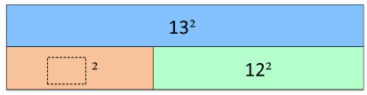
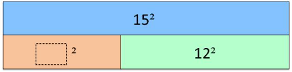

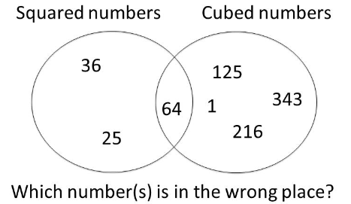





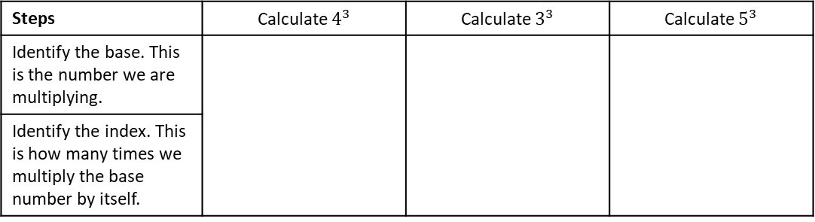







To be able to recall the cube numbers up to 10 cubed
Example 10 - I do…
Example 11 – We do…
Example 12 – You do…
Steps | Calculate $4^{3}$ | Calculate $3^{3}$ | Calculate $5^{3}$
Identify the base. This is the number we are multiplying.
Identify the index. This is how many times we multiply the base number by itself.
Independent Practice
4. Calculate the value of:
a)$1^{3}$
b)$2^{3}$
c)$3^{3}$
d)$4^{3}$
e)$5^{3}$
f)$6^{3}$
g)$7^{3}$
h)$8^{3}$
i)$9^{3}$
j) ${10}^{3}$
k)$2^{3}+1^{3}$
l)$2^{3}−1^{3}$
Mixed Practice
5. Fill in the blanks:
a)
6. Circle the number that is in the wrong
place in the Venn diagram:

Slide 44



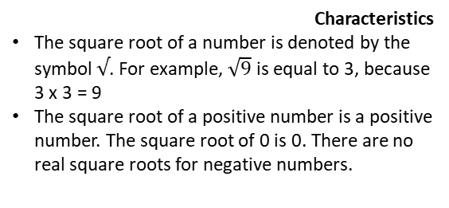











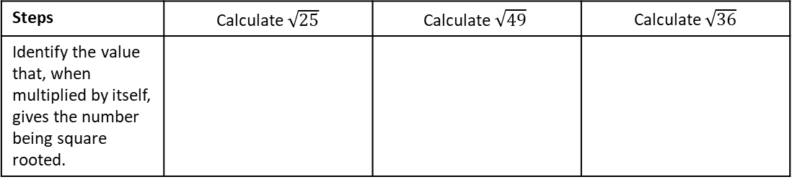

Square roots
Objectives:
To be able to recognise square roots as inverses of squares
To be able to recognise cube roots as inverses of cubes
Keywords:
- Square root
- Cube root
Introduction – Read and annotate:
Square roots and cube roots are the opposite, or inverse operations, of squaring and cubing. A square
root finds the original number that was squared, while a cube root finds the original number that was
cubed. Square and cube roots are especially important in algebra and geometry, where they help solve
equations involving areas, volumes and distances (Pythagoras’ Theorem).
The square root of a number is a value that, when multiplied by itself, gives the original number.
Definition
Characteristics
The square root of a number is denoted by the symbol $√$. For example, $\sqrt{9}$ is equal to 3, because 3 x 3 = 9
The square root of a positive number is a positive number. The square root of 0 is 0. There are no real square roots for negative numbers.
Examples
Square root
Non - Examples
$\sqrt{16}$ = 4, because 4 x 4 = 16
$$\sqrt[3]{}$$
$$\sqrt{\frac{25}{16}}$$
$\sqrt{1}$ = 1, because 1 x 1 = 1
$$\frac{\sqrt{25}}{\sqrt{16}}$$
$$\sqrt{4+5}$$
3
$\sqrt{0}$ = 0, because 0 x 0 = 0
$$\sqrt{5+12}$$
Calculating square roots up to $\sqrt{225}$
Example 1 - I do…
Example 2 – We do…
Example 3 – You do…
Steps | Calculate $\sqrt{25}$ | $$\text{Calculate} \sqrt{49}$$ | Calculate $\sqrt{36}$
Identify the value that, when multiplied by itself, gives the number being square rooted.
Independent Practice
1. Calculate the following:
a) $\sqrt{4}$
b) $\sqrt{9}$
c) $\sqrt{1}$
d) $\sqrt{64}$
f) $\sqrt{0}$
g) $\sqrt{121}$
h) $\sqrt{100}$
i) $\sqrt{81}$

Slide 45



















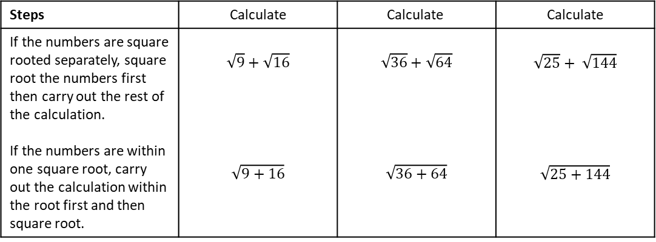





k) $\sqrt{144}$
l) $\sqrt{169}$
m) $\sqrt{196}$
n) $\sqrt{225}$
o) $\sqrt{400}$
p $\sqrt{900}$
q) $\sqrt{6400}$
r) $\sqrt{4900}$
Example 4 - I do…
Example 5 – We do…
Example 6 – You do…
Steps | Calculate | $$\text{Calculate}$$ | Calculate
If the numbers are square rooted separately, square root the numbers first then carry out the rest of the calculation. If the numbers are within one square root, carry out the calculation within the root first and then square root. | $$\sqrt{9}+\sqrt{16}$$ $$\sqrt{9+16}$$ | $$\sqrt{36}+\sqrt{64}$$ $$\sqrt{36+64}$$ | $$\sqrt{25}+ \sqrt{144}$$ $$\sqrt{25+144}$$
Independent Practice
2. Calculate the following:
a) $\sqrt{4}$
b) $\sqrt{3+1}$
c) $\sqrt{4}+\sqrt{1}$
d) $\sqrt{64}$
e) $\sqrt{32+32}$
f) $\sqrt{16}+\sqrt{25}$
g) $\sqrt{121−21}$
h) $\sqrt{64+36}$
i)$\sqrt{13+3}$
j) $\sqrt{5×5}$
k) $\sqrt{40−4}$
l) $\sqrt{225}$
m) $\sqrt{0}+\sqrt{1}$
n) $\sqrt{5+4}$
o) $\sqrt{10+1−2}$
p) $\sqrt{16}−\sqrt{9}+\sqrt{1}$

Slide 46
Subtopic 7a - Positive Indices and Laws of Indices
Objectives:
LEARNING OUTCOME: Understand the laws of indices
Keywords:
Equations
Indices
Exponents
Expressions
Variables
Write a number as a power of another number.
Understand what the different laws of Indices are.
How to multiply and divide indices
Look at problem solving questions.
Definition
Characteristics
Index laws are the rules that we must follow when simplifying algebraic or numerical terms involved indices
These can involve negatives addition and subtraction rules
Every different style of number, e.g. integer, fraction, negative, performs a different action
4⁶ = 4 × 4 × 4 × 4 × 4 × 4 | six lots of 4 multiplied together
6⁴ = 6 × 6 × 6 × 6 | four lots of 6 multiplied together
7³ = 7 × 7 × 7
Examples
Index Laws
Non - Examples
$a^{8}×a^{3}=a^{24},$ This is a non-example as the powers have been multiplied
$b^{10}÷b^{2}=b^{5},$ This is a non-example as the powers have been divided
$({c^{4})}^{2}=c^{16},$ This is a non-example as the powers have been powered
You can write a million as 1 000 000 = 10⁶.
A number multiplied by itself is the number ‘squared’. You need to know the square numbers (power 2) up to 15² = 225. How many of them can you write down from memory? You will also find it helpful to know the cubes numbers (power 3) up to 6³ = 216
$a^{2}×a^{4}=a^{6},$ The powers are added under multiplication
$b^{7}÷b^{2}=b^{5},$ The powers are subtracted under division
${{(c}^{3})}^{3}=c^{9},$ The powers are multiplied under power rules
Example 1 - I do…
Example 2 - We do…
Example 3 - You do…
Steps | Express in index notation | Express in index notation | Express in index notation
1) Count how many of the same base (number or letter) there are. | $2×2×2$ $$2×2×2×5×5$$ | $$3×3×3×3×3$$ $$3×3×3×4×4$$ | $$9×9×9×9$$ $$5×5×9×9$$
2) Write the total amounts of each number or letter as an index of each value.
INDEPENDENT PRACTICE
1. Write these expressions in index notation.
a) $2 × 2 × 2× 2$ | b) $3 × 3 × 3 × 3 × 3$
c) $7 × 7$ | d) $12× 12× 12$
e) $0.7× 0.7× 0.7× 0.7$ | f) $2×2×3×3$
g) $3 × 3 × 3×7 × 7$ | h) $7×7×7×7×12×12×12×15×15$
i) $12× 12× 12×0.7×0.7$ | j) $0.7× 0.7× 0.7× 0.7×0.3×0.3$

Slide 47
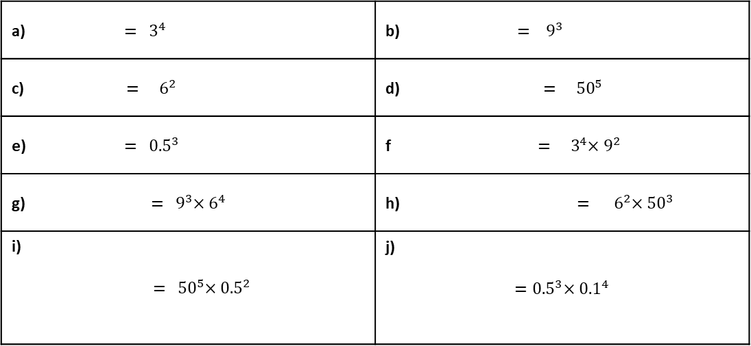
Example 4 - I do…
Example 5 - We do…
Example 6 - You do…
Steps | Express in expanded form
1) Look at the index of each base number or letter, write out that many of the value as a product | $$4^{5}$$ $$4^{5}×8^{2}$$ | $$6^{2}$$ $$6^{2}×7^{3}$$ | $$9^{3}$$ $$9^{4}×11^{3}$$
INDEPENDENT PRACTICE
2. Write these expressions in expanded form.
a) ${ = 3}^{4}$ | b) ${ = 9}^{3}$
c) ${ = 6}^{2}$ | d)${= 50}^{5}$
e) ${ = 0.5}^{3}$ | f${ = 3}^{4}×9^{2}$
g) ${ = 9}^{3}×6^{4}$ | h) ${ = 6}^{2}×{50}^{3}$
i) $${ = 50}^{5}×{0.5}^{2}$$ | j) $${=0.5}^{3}×{0.1}^{4}$$
Example 7 - I do…
Example 8 - We do…
Example 9 - You do…
Steps | Express in index notation
1) Count how many of the same base (number or letter) there are. | $$x×x×x$$ $$c×c×d×d×d×d$$ | $$y×y×y×y×y$$ $$y×y×y×y×z×z$$ | $$a×a$$ $$a×a×b×b×b$$
2) Write the total amounts of each number or letter as an index of each value. | $$c×c×d×d×d×d$$ | $$y×y×y×y×z×z$$ | $$a×a×b×b×b$$

Slide 48
INDEPENDENT PRACTICE
3. Write these in index notation
a) $x×x×x×x$ | b) $y×y×y$
c) $m×m×m×m×m$ | d) $t×t×t×t$
e) $m×m×m×m×m×m$ | f) $t×t×t×t$
g) $w×w×w×w×w$ | h) $x×x×y×y$
i) $t×t×x×x×m×m$ | j) $w×w×w×t×t×y×y×y×y$
Example 10 - I do…
Example 11 - We do…
Example 12 - You do…
Steps | Express in expanded form
1) Look at the index of each base (number or letter), write out that many of the value as a product | $$x^{5}$$ $$x^{5}×y^{2}$$ | $$y^{3}$$ $$y^{2}×z^{2}$$ | $$a^{2}$$ $$a^{3}×b^{4}$$
INDEPENDENT PRACTICE
4. Write these out in expanded form.
a) $x^{3}$ | b) $y^{4}$
c) $m^{4}$ | d) $z^{3}×w^{4}$
e) $a^{5}×b$ | f) $c^{3}×d^{2}$
g) $a×b^{2}×c^{3}$ | h) $d^{4}×e^{3}×f^{3}$
i) $z^{3}×w^{4}×m^{5}$ | j) $h^{3}×m^{2}×n^{4}$

Slide 49
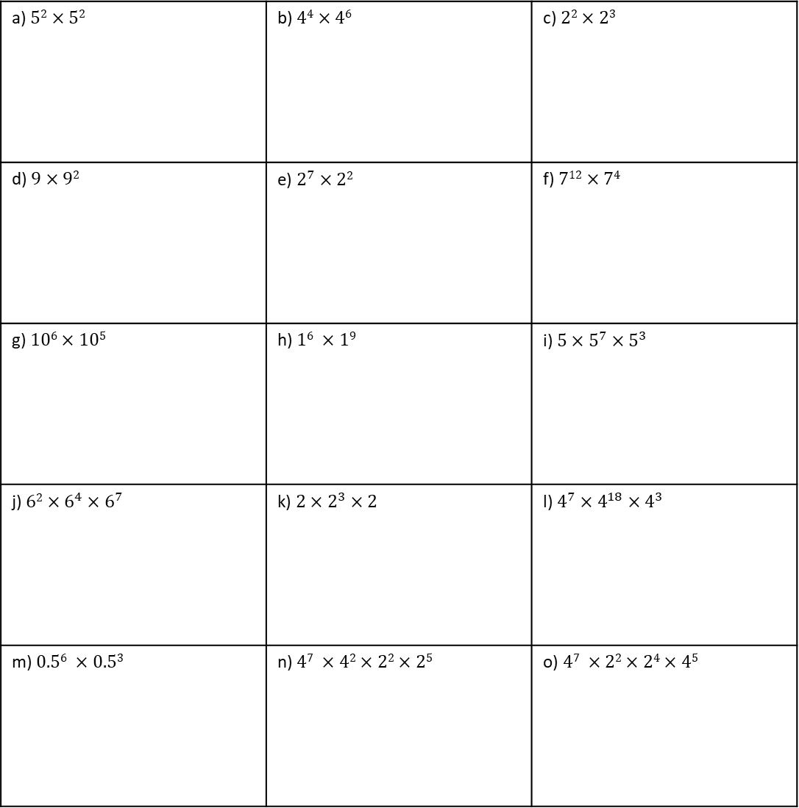
Example 13 - I do…
Example 14 – We do…
Example 15 – You do…
Steps | Simplify
 | $$5^{2}×5^{4}$$ | $$4^{2}×4×4^{3}$$ | $$7^{3}×7^{2}$$
INDEPENDENT PRACTICE
5. Simplify.
a) $52×52$ | b) $44×46$ | c) $22×23$
d) $9×92$ | e) $2^{7}×22$ | f) $712×74$
g) $106×105$ | h) $16 ×19$ | i) $5×5^{7}×5^{3}$
j) $62×6^{4}×6^{7}$ | k) $2×2^{3}×2$ | l) $4^{7}×4^{18}×4^{3}$
m) $0.56 ×0.53$ | n) $47 ×42×22×25$ | o) $47 ×22×24×45$

Slide 50
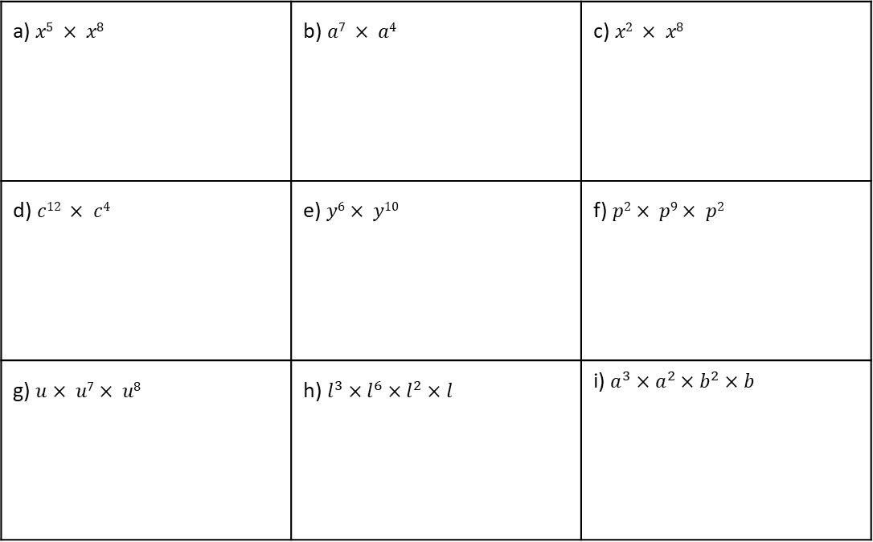
Example 16 - I do…
Example 17 – We do…
Example 18 – You do…
Steps | Simplify
 | $$a^{4}×a^{3}$$ | $$b^{2}×b^{2}×b^{3}$$ | $$c^{3}×c×c^{2}$$
INDEPENDENT PRACTICE
6. Simplify.
a) $x5 × x8$ | b) $a7 × a4$ | c) $x2 × x8$
d) $c12 × c4$ | e) $y6× y10$ | f) $p2× p9× p2$
g) $u× u7× u8$ | h) $l^{3}×l^{6}×l^{2}×l$ | i) $a^{3}×a^{2}×b^{2}×b$
KNOWLEDGE CHECK
7. Work out.
9 + -3 = | b) 10 + -4 = | c) 15 + -10 = | d) 23 + -17 =
e) 4 + -5 = | f) -6 + 7 = | g) -8 + 12 = | h) -12 + 8 =
i) -9 + -3 = | j) -10 + -4 = | k) -5 + -10 = | l) -23 + -17 =

Slide 51
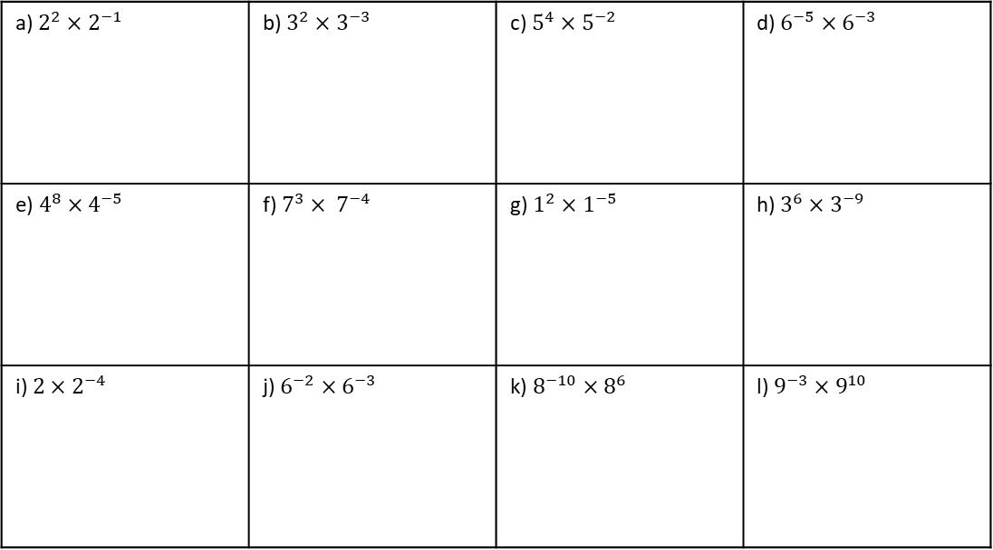
Example 19 - I do…
Example 20 – We do…
Example 21 – You do…
Steps | Simplify
When multiplying powers with the same base, we ADD the indices. | $$5^{2}×5^{−4}$$ $$5^{−2}×5^{−4}$$ | $$4^{−2}×4^{9}$$ $$4^{−2}×4^{−9}$$ | $$2^{4}×2^{−3}$$ $$2^{−4}×2^{−3}$$
INDEPENDENT PRACTICE
8. Simplify
a) $2^{2}×2^{−1}$ | b) $3^{2}×3^{−3}$ | c) $5^{4}×5^{−2}$ | d) $6^{−5}×6^{−3}$
e) $4^{8}×4^{−5}$ | f) $7^{3}× 7^{−4}$ | g) $1^{2}×1^{−5}$ | h) $3^{6}×3^{−9}$
i) $2×2^{−4}$ | j) $6^{−2}×6^{−3}$ | k) $8^{−10}×8^{6}$ | l) $9^{−3}×9^{10}$
Example 22 - I do…
Example 23 – We do…
Example 24 – You do…
Steps | Simplify
When multiplying powers with the same base, we ADD the indices. | $$b^{−7}×b^{9}$$ | $$m^{−3}×m^{−5}$$ | $$t^{5}×t^{−3}$$

Slide 52
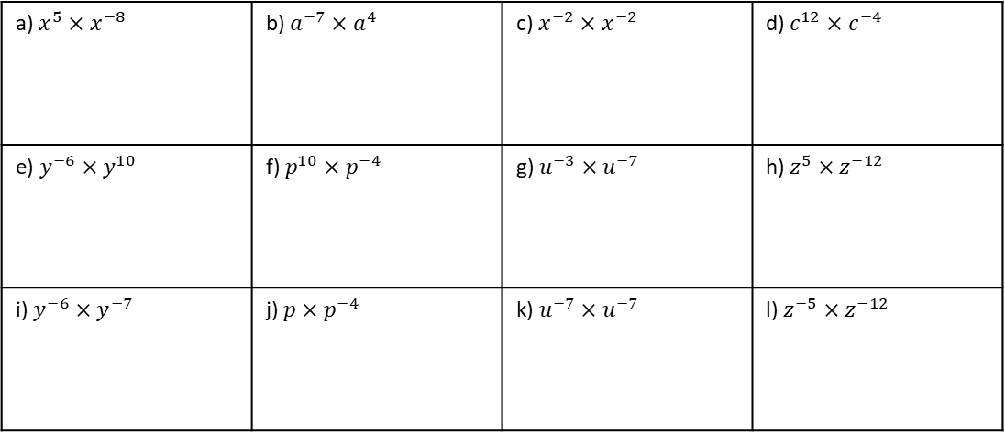
INDEPENDENT PRACTICE
9. Simplify
a) $x^{5}×x^{−8}$ | b) $a^{−7}×a^{4}$ | c) $x^{−2}×x^{−2}$ | d) $c^{12}×c^{−4}$
e) $y^{−6}×y^{10}$ | f) $p^{10}×p^{−4}$ | g) $u^{−3}×u^{−7}$ | h) $z^{5}×z^{−12}$
i) $y^{−6}×y^{−7}$ | j) $p×p^{−4}$ | k) $u^{−7}×u^{−7}$ | l) $z^{−5}×z^{−12}$
Example 25 - I do…
Example 26 – We do…
Example 27 – You do…
Steps | Simplify | Simplify | Simplify
Multiply the coefficients. | $$4x^{2}×{5x}^{3}$$ | $$2x^{5}×x^{4}$$ | 5$x^{2}×{3x}^{7}$
Multiply the variables (add the indices)
Simplify (put together)
INDEPENDENT PRACTICE
9. Simplify
$$a) 2x^{2}×x^{3}$$
$$b) 4x^{7}×x^{10}$$
$$c) x^{5}×{8x}^{5}$$
$$d) 2x^{3}×{3x}^{5}$$
$$e) 4x^{8}×{4x}^{2}$$
$$f) {5x}^{2}×3x$$
$$g) 7x^{2}×{4x}^{8}$$
$$h) 4x^{10}×{10x}^{2}$$
$$i) {3x}^{5}×8x^{5}$$

Slide 53
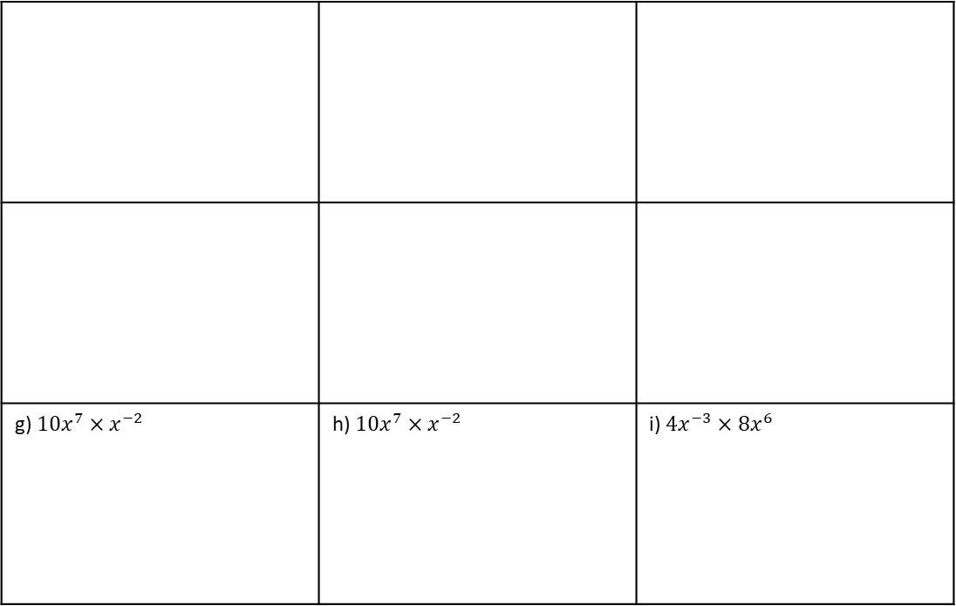
$$j) 11x^{22}×{4x}^{8}$$
$$k) 3x^{8}×{2x}^{2}$$
$$l) 3x^{5}×{7x}^{3}$$
$$m) 8x^{2}×{2x}^{3}$$
$$n) 15x^{6}×3x$$
$$o) x^{5}×9x^{10}$$
Example 28 - I do…
Example 29 – We do…
Example 30 – You do…
Steps | Simplify
Multiply the coefficients. | $$5x^{−2}×x^{−3}$$ | $$2x^{5}×{3x}^{−3}$$ | $$2x^{−2}×{4x}^{5}$$
Multiply the variables (add the indices)
Simplify (put together)
INDEPENDENT PRACTICE
11. Simplify
g) $10x^{7}×x^{−2}$ | h) $10x^{7}×x^{−2}$ | i) $4x^{−3}×8x^{6}$
a) $7x^{−2}×4x4$
b) $2x^{−4}×11x^{−7}$
c) $6x^{−7}×6x^{−11}$
d) $3x^{−2}×8x^{−6}$
e) $5x^{−4}×5x^{2}$
f) $12x^{−8}×3x^{−4}$

Slide 54
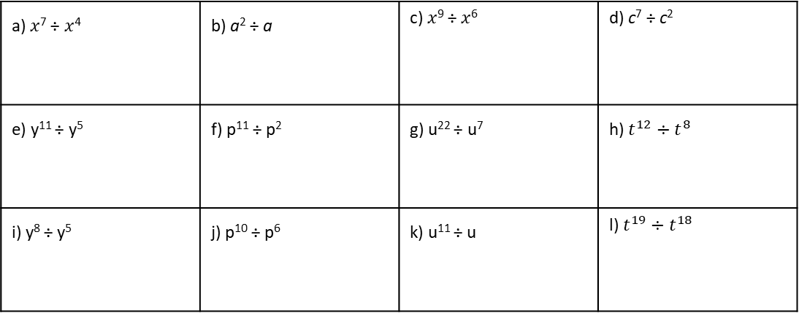
Example 31 - I do…
Example 32 – We do…
Example 33 – You do…
Steps | Simplify
 | $5^{7}÷5^{4}$ $$x^{6}÷x^{4}$$ | $$4^{5}÷4^{3}$$ $$y^{4}÷y^{3}$$ | $$8^{7}÷8^{3}$$ $$z^{5}÷z^{2}$$
INDEPENDENT PRACTICE
12. Simplify
a) 3² ÷ 3² | b) 4⁴ ÷ 4³ | c) 2⁷ ÷ 2⁵ | d) 9⁵ ÷ 9²
e) 2¹⁰ ÷ 2² | f) 7¹² ÷ 7⁴ | g) 10¹⁰ ÷ 10⁵ | h) 1⁶ ÷ 1
i) 5⁹ ÷ 5⁸ | j) 6¹⁴ ÷ 6¹⁰ | k) 2¹¹ ÷ 2 | l) 4²⁰ ÷ 4¹⁸
13. Simplify
a) $x$⁷ ÷ $x$⁴ | b) a² ÷ a | c) $x$⁹ ÷ $x$⁶ | d) c⁷ ÷ c²
e) y¹¹ ÷ y⁵ | f) p¹¹ ÷ p² | g) u²² ÷ u⁷ | h) $t^{12}÷t^{8}$
i) y⁸ ÷ y⁵ | j) p¹⁰ ÷ p⁶ | k) u¹¹ ÷ u | l) $t^{19}÷t^{18}$

Slide 55
KNOWLEDGE CHECK
14. Work out.
a) 3 - 5 = | b) 1 – 5 = | c) 2 – 7 = | d) 6 – 10 =
e) 13 – 28 = | f) -3 – 5 = ` | g) -1 – 5 = | h) -1 – -5 =
i) -2 – -7 = | j) -3 – -1 = | k) 12.3 – 14 = | l) -12.3 – 14 =
Example 34 - I do…
Example 35 – We do…
Example 36 – You do…
Steps | Simplify
When dividing powers with the same base, we SUBTRACT the indices. | $$5^{7}÷5^{−4}$$ $$x^{9}÷x^{−4}$$ | $$4^{−12}÷4^{9}$$ $$x^{−2}÷x^{5}$$ | $$8^{−4}÷8^{−9}$$ $$x^{−6}÷x^{−2}$$
INDEPENDENT PRACTICE
14. Simplify
a) 4² ÷ 4⁻¹ | b) 5² ÷ 5⁻³ | c) 7⁴ ÷ 7⁻² | d) 2⁵ ÷ 2⁻³
e) 9⁸ ÷ 9⁻⁵ | f) 5³ ÷ 5⁻⁴ | g) 1² ÷ 1⁻⁵ | h) 6⁶ ÷ 6⁻⁹
i) 6 ÷ 6⁻⁴ | j) 8⁻² ÷ 8³ | k) 8⁻⁴ ÷ 8⁶ | l) 2⁻³ ÷ 2¹⁰

Slide 56
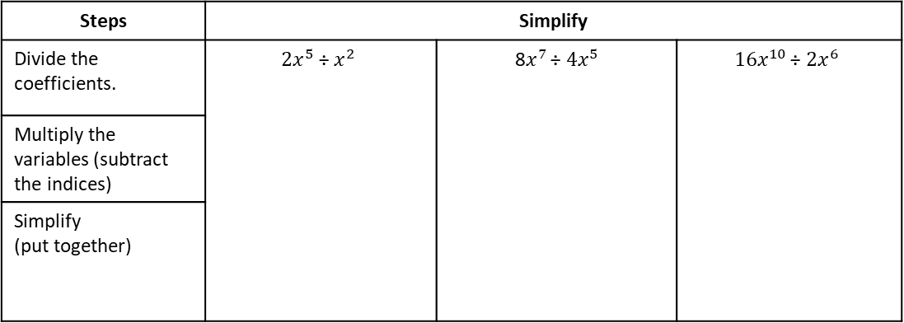

15. Simplify
a) $x5 ÷ x^{−8}$ | b) $a^{−7} ÷ a4$ | c) $x^{−2} ÷ x^{−2}$ | d) $c^{−12} ÷ c4$
e) $y^{−6} ÷ y10$ | f) $p^{−2} ÷ p9$ | g) $u ÷ u^{−7}$ | h) $t^{9}÷t^{−3}$
Example 37 - I do…
Example 38 – We do…
Example 39 – You do…
Steps | Simplify
Divide the coefficients. | $$2x^{5} \text{÷} x^{2}$$ | 8$x^{7 }\text{÷} {4x}^{5}$ | $$16x^{10 }\text{÷} {2x}^{6}$$
Multiply the variables (subtract the indices)
Simplify (put together)
INDEPENDENT PRACTICE
16. Simplify
a) $6x7 ÷ 3x4$
b) $6x8 ÷ 2x3$
c) $6x11 ÷ 6x7$
d) $24b12 ÷ 8b9$
e) $18b14 ÷ 2b2$
f) $9b7 ÷ 3b2$
g) $7c9 ÷ c4$
h) $20c7 ÷ 5c4$
i) $45c7 ÷ 9c7$

Slide 57

Example 43 - I do…
Example 44 – We do…
Example 45 – You do…
Steps | Simplify
 | $${\left(5^{2}\right)}^{3}$$ $${\left(x^{2}\right)}^{3}$$ | $${\left(3^{4}\right)}^{2}$$ $${\left(y^{6}\right)}^{2}$$ | $${\left(7^{5}\right)}^{3}$$ $${\left(z^{3}\right)}^{4}$$
INDEPENDENT PRACTICE
18. Simplify
a) ${\left(6^{3}\right)}^{2}$ | b) ${\left(3^{4}\right)}^{2}$ | c${\left(5^{4}\right)}^{3}$ | d) ${\left({10}^{10}\right)}^{2}$
e) ${\left(8^{2}\right)}^{5}$ | f) ${\left(2^{6}\right)}^{3}$ | g) ${\left(9^{7}\right)}^{5}$ | h) ${\left({12}^{12}\right)}^{5}$
i) ${\left(9^{3}\right)}^{5}$ | j) ${\left(2^{9}\right)}^{3}$ | k) ${\left({10}^{7}\right)}^{8}$ | l) ${\left({11}^{13}\right)}^{12}$
m) $(x2)2$ | n) (m³)² | o) (s⁵)³ | p) (d¹¹)²
q) (y⁶)⁷ | r) (t⁵)¹⁰ | s) (d²)² | t) (c⁵)⁹

Slide 58

KNOWLEDGE CHECK
19. Work out.
a) 9 × -3 = | b) 10 × -4 = | c) 15 × -10 = | d) -2 × -7 =
e) 4 × -5 = | f) -6 × 7 = | g) -8 × 12 = | h) -12 × 8 =
i) -9 × -3 = | j) -10 × -4 = | k) -0.5 × -10 = | l) -23 × -17 =
Example 46 - I do…
Example 47 – We do…
Example 48 – You do…
Steps | Simplify
We MULTIPLY the indices. | $${\left(5^{2}\right)}^{−3}$$ $${\left(x^{−2}\right)}^{−3}$$ | $${\left(6^{−4}\right)}^{2}$$ $${\left(y^{−10}\right)}^{−2}$$ | $${\left(8^{−3}\right)}^{−4}$$ $${\left(z^{−5}\right)}^{4}$$
INDEPENDENT PRACTICE
20. Simplify
a) ${\left(6^{−3}\right)}^{8}$ | b) ${\left(3^{4}\right)}^{−2}$ | c) ${\left(5^{3}\right)}^{−3}$ | d) ${\left({10}^{−10}\right)}^{10}$
e) ${\left(8^{−2}\right)}^{−5}$ | f) ${\left(2^{−6}\right)}^{3}$ | g) ${\left(9^{7}\right)}^{−5}$ | h) ${\left({12}^{−12}\right)}^{12}$
i) ${\left(8^{−3}\right)}^{−7}$ | j) ${\left(9^{−7}\right)}^{3}$ | k)${\left(x^{2}\right)}^{−2}$ | l)${\left(m^{3}\right)}^{2}$
m) ${\left(c^{5}\right)}^{−3}$ | n) ${\left(d^{−11}\right)}^{2}$ | o) ${\left(y^{6}\right)}^{−7}$ | p) ${\left(t^{−5}\right)}^{−10}$

Slide 59

Subtopic 7b – Zero and Negative Indices
LEARNING OUTCOME: State and apply the definition of zero, negative indices
Objectives:
Keywords:
Negative Indices
Zero Indices
Positive Integers
Expressions
Index Notation
How to calculate zero indices.
Understand and calculate negative indices.
Apply understanding of the above to problem solving questions.
Definition
Characteristics
When the index of a value is negative we must make the value the reciprocal of it, to then resolve the index.
If an index is 0, the answer is always 1
Negative powers will result in fractions, often have a large square number as its denominator
0 powers make the answer always 1
4⁶ = 4 × 4 × 4 × 4 × 4 × 4 | six lots of 4 multiplied together
6⁴ = 6 × 6 × 6 × 6 | four lots of 6 multiplied together
7³ = 7 × 7 × 7
Examples
Negative Indices
Non - Examples
$a^{0}=1$, anything to the power 0 is 1
$b^{−7}={\left(\frac{1}{b}\right)}^{7}=\frac{1}{b^{7}}$, the reciprocal is taken then the powered
${\left(\frac{3}{4}\right)}^{−2}={\left(\frac{4}{3}\right)}^{2}=\left(\frac{4^{2}}{3^{2}}\right)=\frac{16}{9}$, if a fraction is raised to the negative power, then the reciprocal of the fraction is taken
$8^{0}=0$, this is a non-example as the value has been multiplied by 0
$b^{−10}=−b^{10},$ This is a non-example as the base has become negative, rather than the reciprocal
${\left(\frac{2}{5}\right)}^{2}=\frac{4}{10}$This is a non-example as the values have been multiplied rather than squared
You can write a million as 1 000 000 = 10⁶.
A number multiplied by itself is the number ‘squared’. You need to know the square numbers (power 2) up to 15² = 225. How many of them can you write down from memory? You will also find it helpful to know the cubes numbers (power 3) up to 6³ = 216
Knowledge check
1. Evaluate
a) $1^{0}$ | b) $1^{1}$ | c) $1^{2}$ | d) $1^{3}$ | e) $1^{4}$
f) $2^{0}$ | g) $2^{1}$ | h) $2^{2}$ | i) $2^{3}$ | j) $2^{4}$
k) $3^{0}$ | l) $3^{1}$ | m) $3^{2}$ | n) $3^{3}$ | o) $3^{4}$
p) $4^{0}$ | q) $4^{1}$ | r) $4^{2}$ | s) $4^{3}$ | t) $4^{4}$
u) $5^{0}$ | v) $5^{1}$ | w) $5^{2}$ | x) $5^{3}$ | y) $5^{4}$

Slide 60

Example 1 - I do…
Example 2– We do…
Example 3 – You do…
Steps | Evaluate | Evaluate | Evaluate
 | $$2^{0}$$ | $$a^{0}$$ | $${\left(−2\right)}^{0}$$
 | $${\left(\frac{1}{2}\right)}^{0}$$ | $${\left(\frac{a}{b}\right)}^{0}$$ | $${\left(−\frac{3}{4}\right)}^{0}$$
INDEPENDENT PRACTICE
2. Evaluate
a) | b) | c) | d)
e) | f) | g) | h)
$5^{0}$
${\left(\frac{1}{5}\right)}^{0}$
${\left(−\frac{1}{5}\right)}^{0}$
${(−5)}^{0}$
$x^{0}$
${\left(−\frac{1}{x}\right)}^{0}$
$(−{x)}^{0}$
${\left(\frac{1}{x}\right)}^{0}$
Example 4 - I do…
Example 5– We do…
Example 6 – You do…
Steps | Write as a fraction in simplest form | Evaluate | Evaluate
When a fraction is raised to a power, both numerator and denominator is raised to the power. | $${\left(\frac{1}{2}\right)}^{1}$$ | $${\left(\frac{a}{b}\right)}^{1}$$ | $${\left(\frac{3}{4}\right)}^{1}$$
 | $${\left(\frac{1}{2}\right)}^{3}$$ | $${\left(\frac{a}{b}\right)}^{2}$$ | $${\left(\frac{3}{4}\right)}^{3}$$
INDEPENDENT PRACTICE
3. Write as a single fraction in simplest form.
${\left(\frac{1}{5}\right)}^{2}$
${\left(\frac{1}{9}\right)}^{2}$
${\left(\frac{2}{5}\right)}^{3}$
${\left(\frac{c}{d}\right)}^{2}$
a) | b) | c) | d)
e) | f) | g) | h)
${\left(\frac{1}{2^{3}}\right)}^{2}$
${\left(\frac{2^{0}}{3^{3}}\right)}^{2}$
${\left(\frac{2^{3}}{5}\right)}^{2}$
${\left(\frac{a^{5}}{b^{3}}\right)}^{2}$

Slide 61

Example 7 - I do…
Example 8– We do…
Example 9 – You do…
Steps | Evaluate | Simplify | Evaluate
When a base has a negative index, we take the RECIPROCAL of the base. | $$2^{−1}$$ | $$a^{−1}$$ | $$4^{−1}$$
 | $$2^{−2}$$ | $$a^{−3}$$ | $$4^{−3}$$
INDEPENDENT PRACTICE
4. Simplify.
a) | b) | c) | d)
e) | f) | g) | h)
$x^{−2}$
$x^{−3}$
$x^{−4}$
$x^{−5}$
${(ab)}^{−2}$
${ab}^{−2}$
$a^{−2}$ $b^{−2}$
$$a^{2}b^{−2}$$
5. Evaluate.
a) | b) | c) | d)
e) | f) | g) | h)
i) | j) | k) | l)
m) | n) | o) | p)
2⁻²
3⁻²
10⁻²
4⁻²
9⁻²
8⁻²
7⁻²
6⁻²
$3^{−3}$
$4^{−3}$
$5^{−3}$
${10}^{−3}$
$$2^{−2}+2^{−3}$$
$$2^{−2}+3^{−2}$$
$$2^{−3}+3^{−2}$$
$$2^{−3}×3^{−2}$$

Slide 62

GCSE Past Paper Questions

Slide 63


Slide 64





Subtopic 8 (Crossover) – Standard Form
LEARNING OUTCOME: Understand and compare numbers in standard form
Objectives:
Keywords:
Standard form
Indices
Place value
Decimal point
Index Notation
Understand standard form.
Convert numbers to and from standard form.
Definition
Characteristics
Standard form is the way to represent very large of very small numbers. It is used in science to show size of cells or distances in space
Written in the form $A×{10}^{n}$, where A is a number between 1 and 10, and n is a positive or negative integer
Standard form is written with the first number being a number between 1 and 10. This can be a decimal
We then multiply it by a power of 10, either positive or negative. Positive powers represent large numbers, negative powers represent small
4⁶ = 4 × 4 × 4 × 4 × 4 × 4 | six lots of 4 multiplied together
6⁴ = 6 × 6 × 6 × 6 | four lots of 6 multiplied together
7³ = 7 × 7 × 7
Standard Form
Examples
Non - Examples
You can write a million as 1 000 000 = 10⁶.
A number multiplied by itself is the number ‘squared’. You need to know the square numbers (power 2) up to 15² = 225. How many of them can you write down from memory? You will also find it helpful to know the cubes numbers (power 3) up to 6³ = 216
$3.6×{10}^{4}$ is an example of standard form, this number is 36000
$7.5×{10}^{−2}$ is an example of standard form, this number is the 0.075
$56.7×{10}^{4}$ is a none example as the first number is not between 1 and 10
$3.5÷{10}^{−2}$ is a none example as we always multiply by the factor of 10.
KNOWLEDGE CHECK
1. Write each of the following as a power of 10.
a) $10×10$ | b) $10×10×10$ | c) $10×10×10×10$ | d) 10,000 | e) 1000
f) 100 | g) 10 | h) 1 | i) 0.1 | j) 0.01
2. Write each of the following as ordinary number.
a) ${10}^{4}$ | b)${10}^{2}$ | c)${10}^{5}$ | d) ${10}^{0}$ | e) ${10}^{1}$
f) ${10}^{4}×{10}^{1}$ | g) ${10}^{2}×{10}^{3}$ | h) ${10}^{4}×{10}^{−1}$ | i) ${10}^{−1}$ | j) ${10}^{−2}$

Slide 65
Example 1 - I do…
Example 2– We do…
Example 3 – You do…
Steps | Write in standard form.
1) Set the first digit to be between 1 and 10. | a) 500 | a) 300 | 800
 | b) 5000 | b) 50,000 | b) 2000
2) Show how many times you must multiply by 10 to represent the number
 | c) 5,000,000 | c) 6000 | c) 900,000
INDEPENDENT PRACTICE
3. Write each of the following in standard form.
20 | b) 30 | c) 70 | d) 100
e) 200 | f) 2000 | g) 400 | h) Seven hundred
900 | j) 1000 | k) 40 000 | l) Sixty thousand
m) 90 million | n) Four hundred | o) 10 | p) 1

Slide 66
Example 4 - I do…
Example 5– We do…
Example 6 – You do…
Steps | Write in standard form.
1) Set the first digit to be between 1 and 10. | a) 120 | a) 360 | 820
 | b) 1200 | b) 48000 | b) 4500
2) Show many times you must multiply by 10 to represent the number
 | c) 12300 | c) 148000 | c) 12700
INDEPENDENT PRACTICE
4. Write each of the following in standard form.
350 | b) 3500 | c) 35300 | d) 53300
e) 355 000 | f) 530 000 | g) 35 million | h) 5300
i) 3300 | j) 55 000 | k) One hundred and thirty five thousand. | l) 350 000 000
m) 20 200 | n) 202 230 | o) 2023 | p) 20 300

Slide 67


Example 7- I do…
Example 8– We do…
Example 9 – You do…
Steps | Write as ordinary number. | Write as an ordinary number | Write as an ordinary number
1) Write the power of 10 as ordinary number. | a) $3×{10}^{2}$ | a) $7×{10}^{2}$ | a) $8×{10}^{2}$
 | b) $3.5×{10}^{3}$ | b) $7.5×{10}^{4}$ | b) $2.1×{10}^{5}$
2) Multiply the decimal by the integer.
 | c) $3.53×{10}^{3}$ | c) $7.23×{10}^{3}$ | c) $2.18×{10}^{4}$
INDEPENDENT PRACTICE
5. Write each of the following as an ordinary number.
a) $2×{10}^{2}$ | b) $3×{10}^{2}$ | c) $4×{10}^{3}$ | d) $7×{10}^{2}$
e) $5×{10}^{4}$ | f) $6×{10}^{3}$ | g) $7×{10}^{3}$ | h) $8×{10}^{3}$
i) $5.1×{10}^{2}$ | j) $6.3×{10}^{2}$ | k) $7.1×{10}^{3}$ | l) $8.4×{10}^{3}$
m) $8.3×{10}^{3}$ | n) $8.3×{10}^{4}$ | o) $7.5×{10}^{4}$ | p) $7.5×{10}^{5}$

Slide 68



q) $5.13×{10}^{2}$ | r) $6.32×{10}^{2}$ | s) $7.12×{10}^{3}$ | t) $8.45×{10}^{3}$
u) $5.18×{10}^{2}$ | v) $6.34×{10}^{2}$ | w) $7.17×{10}^{5}$ | x) $8.94×{10}^{6}$
6. Sam has carried out a calculation and written his answer in standard form. He has written is 2400 = 24 × ${10}^{2}$ Correct the mistake. | 7. Place an inequality sign between these numbers to make the statement true (you must show your working: $3.8×{10}^{6}$ _____ $4.2×{10}^{5}$
KNOWLEDGE CHECK
8. Fill in the gaps. The first one has been done for you.
a) ${10}^{−1}=0.1$ $×0.1$ is the same as $÷10$ | b) ${10}^{−2}=____$ $×_____$ is the same as $÷____$
c) ${10}^{−3}=____$______ $×$is the same as $÷$ | d)${10}^{−4}=____$_____ $×$is the same as $÷$
e)${10}^{−5}=____$_____ $×_____________$ is the same as $÷_____________$ | f)${10}^{−6}=_________$ $×_____________$ is the same as $÷_____________$
g)${10}^{−7}=____$_____ $×_____________$ is the same as $÷_____________$ | h)${10}^{−8}=____$_____ $×_____________$ is the same as $÷_____________$

Slide 69


Example 10 - I do…
Example 11– We do…
Example 12 – You do…
Steps | Write in standard form.
1) Write the number as a division | a) $0.9$ | a) $0.3$ | a) $0.2$
 | b) $0.09$ | b) $0.005$ | b) $0.04$
2) Rewrite as a product with a negative power of 10.
 | c) $0.0005$ | c) $0.0007$ | c) $0.0006$
INDEPENDENT PRACTICE
9. Write the following numbers in standard form:
a) $0.2$ | b) $0.3$ | c) $0.5$ | d) $0.8$
e) $0.9$ | f) $0.09$ | g) $0.08$ | h) $0.008$
i) $0.0007$ | j) $8 thousands$ | k) $0.0001$ | l) $0.000005$

Slide 70


Example 13 - I do…
Example 14– We do…
Example 15 – You do…
Steps | Write in standard form.
1) Write the number as a division | a) $0.025$ | a) $0.0259$ | a) $0.0257$
 | b) $0.0102$ | b) $0.00501$ | b) $0.0407$
2) Rewrite as a product with a negative power of 10.
INDEPENDENT PRACTICE
10. Write the following numbers in standard form.
a) $0.034$ | b) $0.0034$ | c) $0.00034$ | d) $0.34$
e) $0.0304$ | f) $0.00304$ | g) $0.43$ | h) $0.000043$
i) $0.0004403$ | j) $0.0044$ | k) $0.0434$ | l) $0.00443$
m) $0.15+0.12$ | n) $0.054+0.005$ | o) $0.1+0.12$ | p) $1−0.25$

Slide 71



Example 16 - I do…
Example 17– We do…
Example 18 – You do…
Steps | Write in ordinary form.
1) Rewrite as a division. | a) $2×{10}^{−1}$ | a) $4×{10}^{−3}$ | a) $5×{10}^{−2}$
 | b) $2×{10}^{−2}$ | b) $2.3×{10}^{−2}$ | b) $2.4×{10}^{−2}$
2) Calculate
 | c) $2.1×{10}^{−5}$ | c) $2.13×{10}^{−5}$ | c) $2.11×{10}^{−1}$
INDEPENDENT PRACTICE
11. Write the following numbers in ordinary form.
a)$5×{10}^{−1}$ | b) $7×{10}^{−2}$ | c) $7×{10}^{−5}$ | d) $4×{10}^{−2}$
e) $7.1×{10}^{−3}$ | f) $7.5×{10}^{−4}$ | g) $7.6×{10}^{−2}$ | h) $5.1×{10}^{−4}$
i) $7.15×{10}^{−3}$ | j) $7.105×{10}^{−4}$ | k) $7.05×{10}^{−2}$ | l) $7.51×{10}^{−7}$
12. Write the following numbers in standard form.
a)$50$ | b) $500$ | c) $250$0 | d) $0.2$

Slide 72









e) $0.25$ | f) $0.025$ | g) $2.5$ | h) $20 million$
13. Write the following numbers in ordinary form.
a) $9×{10}^{2}$ | b) $9×{10}^{−2}$ | c) $9.1×{10}^{5}$ | d) $9.11×{10}^{2}$
e) $9.151×{10}^{−3}$ | f) $9.5011×{10}^{5}$ | g) $9.01×{10}^{−2}$ | h) $9.511×{10}^{−1}$
14. Which of the following are written in correct standard form? Tick all that apply.
a) $1.6 × {10}^{4}$
b) $60×{10}^{−4}$
c) $1.16×{10}^{0.4}$
d) $16×{10}^{−4}$
e) $1.06 ×{10}^{−4}$
f) $0.16 × {10}^{−4}$
Example 19 - I do…
Example 20- We do…
Example 21 - You do…
Steps | Write in standard form
1) Convert the first number to standard form. | a) $60× {10}^{5}$ | a) $16× {10}^{4}$ | a) 5$0× {10}^{5}$
 | b) $600 × {10}^{5}$
2) Use index laws to multiply powers of 10.
 |  | b) $0.01 × {10}^{−3}$ | b) $0.05 × {10}^{−5}$
 | c) $0.6 × {10}^{−5}$

Slide 73

INDEPENDENT PRACTICE
15. Correct these into standard form.
a) $72×{10}^{3}$ | b) $84×{10}^{6}$ | c) $500×{10}^{2}$ | d) $210×{10}^{4}$
e) $0.8×{10}^{7}$ | f) $0.46×{10}^{5}$ | g) $0.06×{10}^{8}$ | h) $0.07×{10}^{12}$
i) $3000×{10}^{14}$ | j) $24×{10}^{−5}$ | k) $0.8×{10}^{−10}$ | l) $0.0055×{10}^{−2}$
m) $68×{10}^{0}$ | n) $70×{10}^{−1}$ | o) $0.7×{10}^{1}$ | p) $7500×{10}^{−2}$
q) $0.0372×{10}^{−9}$ | r) $65213×{10}^{−7}$ | s) $2933×{10}^{21}$ | t) $759300×{10}^{−2}$

Slide 74

MIXED PRACTICE
16. a) Billy says that $6.2×{10}^{−5}$ is bigger than $6.2×{10}^{−4}$ . Is he correct? Explain your reason. b) The distance from the Earth to the Sun is $1.49×{10}^{8}$ 𝑘𝑚. Write this distance as an ordinary number. | 17. a) The population of Vietnam is $9.6×{10}^{7}$ to 2 significant figures. The population of Japan is $1.3×{10}^{8}$ to 2 significant figures. Which country has the greater population? b) The population of the United States is 330 000 000 to 2 significant figures. Write this number in standard form.
18. Anna is asked to compare the following numbers. 𝐴 = $5.72×{10}^{7}$ 𝐵 = $6.28×{10}^{5}$ She says, “6. 28 is bigger than 5. 72 so 𝐵 is bigger than 𝐴”. Is Anna correct? You must give a reason for your answer. | 19. Put these numbers in order of size. Start with the smallest. $0.0034$ $4.1×{10}^{−4}$ $0.24×{10}^{−5}$ $0.00062$

Slide 75




Subtopic 8b – The Four Operations with Standard Form
LEARNING OUTCOME: Perform four operations in standard form.
Objectives:
Keywords:
Standard form
Indices
Place value
Decimal point
Index Notation
Calculate using numbers in standard form.
Apply to problem solving questions.
Definition
Characteristics
Standard form is the way to represent very large of very small numbers. It is used in science to show size of cells or distances in space
Written in the form $A×{10}^{n}$, where A is a number between 1 and 10, and n is a positive or negative integer
Standard form is written with the first number being a number between 1 and 10. This can be a decimal
We then multiply it by a power of 10, either positive or negative. Positive powers represent large numbers, negative powers represent small
4⁶ = 4 × 4 × 4 × 4 × 4 × 4 | six lots of 4 multiplied together
6⁴ = 6 × 6 × 6 × 6 | four lots of 6 multiplied together
7³ = 7 × 7 × 7
Standard Form
Examples
Non - Examples
You can write a million as 1 000 000 = 10⁶.
A number multiplied by itself is the number ‘squared’. You need to know the square numbers (power 2) up to 15² = 225. How many of them can you write down from memory? You will also find it helpful to know the cubes numbers (power 3) up to 6³ = 216
$3.6×{10}^{4}$ is an example of standard form, this number is 36000
$7.5×{10}^{−2}$ is an example of standard form, this number is the 0.075
$56.7×{10}^{4}$ is a none example as the first number is not between 1 and 10
$3.5÷{10}^{−2}$ is a none example as we always multiply by the factor of 10.
Adding and Subtracting
Example 1 - I do…
Example 2 – We do…
Example 3 – You do…
Calculate $\left(2×{10}^{6}\right)−(8×{10}^{5})$
Steps | Calculate the following, write your answer in standard form.
1) Convert both numbers to ordinary form | $$(5×{10}^{4})+(1.5 × {10}^{5})$$ | $$\left(2.5×{10}^{4}\right)+(3×{10}^{3})$$ | $$\left(3.1×{10}^{5}\right)+(2×{10}^{4})$$
2) Add or Subtract
3) Convert back to standard form

Slide 76

INDEPENDENT PRACTICE
1. Calculate the following, give your answers in standard form.
a) $\left(5×{10}^{2}\right)+(3×{10}^{2})$ | b) $\left(5×{10}^{3}\right)+(5×{10}^{4})$ | c) $\left(4×{10}^{2}\right)+(3×{10}^{3})$
d) $\left(6×{10}^{3}\right)+(5×{10}^{4})$ | e) $\left(7×{10}^{3}\right)+(3×{10}^{2})$ | f) $\left(8×{10}^{3}\right)+(5×{10}^{4})$
g) $\left(2×{10}^{2}\right)+(5×{10}^{4})$ | h) $\left(6×{10}^{5}\right)+(5×{10}^{4})$ | i) $\left(2.1×{10}^{2}\right)+(5×{10}^{4})$
j) $\left(6×{10}^{5}\right)+(5.5×{10}^{4})$ | k) $\left(2.1×{10}^{2}\right)+(5.3×{10}^{4})$ | l) $\left(6.2×{10}^{5}\right)+(5.5×{10}^{4})$

Slide 77

2. Calculate the following, give your answers in standard form.
a) $\left(5.9×{10}^{4}\right)+(3.5×{10}^{5})$ | b) $\left(5.4×{10}^{2}\right)+(5.45×{10}^{3})$
c) $\left(5.544×{10}^{6}\right)+(5×{10}^{1})$ | d) $\left(5×{10}^{3}\right)+(2.105×{10}^{3})$
e) $\left(5.12×{10}^{5}\right)+(1.89×{10}^{4})$ | f) $\left(5.122×{10}^{4}\right)+(1.09×{10}^{3})$
g) $\left(5.1022×{10}^{3}\right)+(5.1×{10}^{1})$ | h) $\left(2.512×{10}^{6}\right)+(5.21×{10}^{3})$

Slide 78


Example 4 - I do…
Example 5 – We do…
Example 6 – You do…
Calculate $\left(2.4×{10}^{4}\right)+(1.6×{10}^{2})$
Steps | Calculate the following, give your answer in standard form.
1) Convert both numbers to ordinary form. | $$\left(5×{10}^{5}\right)−(1.5 × {10}^{4})$$ | $$\left(2.5×{10}^{3}\right)−(3.1×{10}^{2})$$ | $$\left(3.1×{10}^{5}\right)−(2.1×{10}^{4})$$
2) Add or Subtract.
3) Convert back to standard form.
INDEPENDENT PRACTICE
3. Calculate the following, give your answers in standard form.
a) $\left(5×{10}^{5}\right)−(3×{10}^{5})$ | b) $\left(7×{10}^{4}\right)−(5×{10}^{3})$ | c) $\left(8×{10}^{6}\right)−(3×{10}^{4})$
d) $\left(9×{10}^{5}\right)−(2×{10}^{3})$ | e) $\left(5.1×{10}^{5}\right)−(2×{10}^{4})$ | f) $\left(5×{10}^{4}\right)−(1.2×{10}^{3})$
g) $\left(5.7×{10}^{3}\right)−(5.3×{10}^{1})$ | h) $\left(2.5×{10}^{6}\right)−(5.2×{10}^{3})$ | i) $\left(7.12×{10}^{3}\right)−(5.1×{10}^{2})$

Slide 79



j) $\left(2.51×{10}^{5}\right)−(5.21×{10}^{3})$ | k) $\left(5.1×{10}^{5}\right)−(5.1×{10}^{4})$ | l) $\left(7×{10}^{1}\right)−(5×{10}^{0})$
Example 7 - I do…
Example 8 – We do…
Example 9 – You do…
Calculate $\left(2.4×{10}^{4}\right)+(1.6×{10}^{2})$
Steps | Calculate the following, leave your answer in standard form.
1) Convert both numbers to ordinary form. | $$\left(5×{10}^{−2}\right)+(1.5 × {10}^{−1})$$ | $$\left(2.5×{10}^{−2}\right)−(3.1×{10}^{−3})$$ | $$\left(8.23×{10}^{−2}\right)+(2.1×{10}^{−4})$$
2) Add or Subtract.
3) Convert back to standard form.
INDEPENDENT PRACTICE
4. Calculate the following, give your answers in standard form.
a)$\left(5×{10}^{−4}\right)+(3×{10}^{−3})$ | b)$\left(5.4×{10}^{−2}\right)+(5.45×{10}^{−3})$ | c) $\left(8×{10}^{−2}\right)−(3×{10}^{−3})$
d)$\left(5.54×{10}^{−2}\right)+(5×{10}^{−1})$ | e)$\left(5×{10}^{−3}\right)−(2.15×{10}^{−3})$ | f)$\left(5.1×{10}^{−1}\right)−(1.89×{10}^{−2})$
g)$\left(5.12×{10}^{−4}\right)−(1.9×{10}^{−3})$ | h)$\left(5×{10}^{3}\right)−(5×{10}^{−1})$ | i)$\left(2.12×{10}^{−3}\right)−(5.1×{10}^{−4})$
Notes:
7

Slide 80




If $A=2.4×{10}^{5}$ and $B=5.8×{10}^{6}$ Determine the value of A + B in standard form. Determine the value of B – A in standard form. | 6. Here are the populations of three European cities: What is the total population of Paris and Rome? Write your answer as an ordinary number to 3 significant figures. What is the difference in population between Paris and Athens? Write your answer in standard form, to 2 significant figures.
7. The UK has an area of approximately $$2.4×{10}^{5}{km}^{2}$$ The USA has an area of approximately $$9.8×{10}^{6}{km}^{2}$$ What is the combined area of the two countries? Give your answer in standard form. What is the difference in the area of the two countries? Give your answer in standard form. | 8. A rectangle has a length $\left(3×{10}^{4}\right)m$ and a width of $(1.8×{10}^{3})$m Work out the perimeter of the rectangle, giving your answer in standard form.
$(1.8×{10}^{3})$m
$(3.6×{10}^{4})$m

Slide 81










Multiplying and Dividing
Example 10 - I do…
Example 11 – We do…
Example 12 – You do…
Calculate $\left(2.4×{10}^{4}\right)+(1.6×{10}^{2})$
Steps | Calculate the following, leave your answer in standard form.
1) Use the associative law to regroup the calculation. | $$\left(2×{10}^{2}\right)×\left(3×{10}^{4}\right)$$ | $$\left(2.5×{10}^{2}\right)×\left(2×{10}^{4}\right)$$ | $$\left(2×{10}^{2}\right)×\left(4×{10}^{4}\right)$$
2) Multiply the numbers without the indices and the powers of 10
3) Check if the answer is in standard form and adjust if necessary.
INDEPENDENT PRACTICE
9. Calculate the following, give your answers in standard form.
a) $\left(2×{10}^{2}\right)×\left(3×{10}^{4}\right)$
b) $\left(3×{10}^{2}\right)×\left(3×{10}^{4}\right)$
c) $\left(2×{10}^{2}\right)×\left(2×{10}^{4}\right)$
d) $\left(2×{10}^{7}\right)×\left(4×{10}^{4}\right)$
e) $\left(1.5×{10}^{2}\right)×\left(2×{10}^{4}\right)$
f) $\left(2×{10}^{2}\right)×\left(3×{10}^{5}\right)$
d) $\left(2.5×{10}^{8}\right)×\left(2×{10}^{4}\right)$
e) $\left(3.2×{10}^{5}\right)×\left(2×{10}^{6}\right)$
f) $\left(2.8×{10}^{4}\right)×\left(2×{10}^{9}\right)$

Slide 82










Example 13 - I do…
Example 14 – We do…
Example 15 – You do…
Calculate $\left(2.4×{10}^{4}\right)+(1.6×{10}^{2})$
Steps | Calculate the following, leave your answer in standard form.
1) Use the associative law to regroup the calculation. | $$\left(2×{10}^{2}\right)×\left(1.5×{10}^{−4}\right)$$ | $$\left(3×{10}^{−2}\right)×\left(3×{10}^{6}\right)$$ | $$\left(2×{10}^{−3}\right)×\left(4×{10}^{5}\right)$$
2) Multiply the numbers without the indices and the powers of 10
3) Check if the answer is in standard form and adjust if necessary.
INDEPENDENT PRACTICE
10. Calculate the following, give your answers in standard form.
a) $\left(2×{10}^{−2}\right)×\left(3×{10}^{4}\right)$
b) $\left(3×{10}^{−2}\right)×\left(3×{10}^{4}\right)$
c) $\left(2×{10}^{−3}\right)×\left(2×{10}^{7}\right)$
d) $\left(2×{10}^{7}\right)×\left(4×{10}^{−4}\right)$
e) $\left(3×{10}^{2}\right)×\left(3×{10}^{−4}\right)$
f) $\left(2×{10}^{−2}\right)×\left(2×{10}^{−5}\right)$
d) $\left(2×{10}^{−5}\right)×\left(4×{10}^{−3}\right)$
e) $\left(2.1×{10}^{−2}\right)×\left(2×{10}^{−4}\right)$
f) $\left(2.8×{10}^{−2}\right)×\left(3×{10}^{−4}\right)$

Slide 83




























Example 16 - I do…
Example 17 – We do…
Example 18 – You do…
Calculate $\left(2.4×{10}^{4}\right)+(1.6×{10}^{2})$
Steps | Calculate the following, leave your answer in standard form.
1) Use the associative law to regroup the calculation. | $$\left(2×{10}^{2}\right)×\left(6×{10}^{4}\right)$$ | $$\left(3×{10}^{−2}\right)×\left(4×{10}^{4}\right)$$ | $$\left(5×{10}^{9}\right)×\left(3×{10}^{−4}\right)$$
2) Multiply the numbers without the indices and the powers of 10
3) Check if the answer is in standard form and adjust if necessary.
$$1.2×{10}^{7}$$
$$1.2×{10}^{3}$$
$$1.5×{10}^{6}$$
INDEPENDENT PRACTICE
11. Calculate the following, give your answers in standard form.
a) $\left(4×{10}^{2}\right)×\left(3×{10}^{4}\right)$
b) $\left(5×{10}^{4}\right)×\left(2×{10}^{4}\right)$
c) $\left(6×{10}^{6}\right)×\left(2×{10}^{4}\right)$
$$1.2×{10}^{7}$$
$$1×{10}^{9}$$
$$1.2×{10}^{11}$$
d) $\left(2×{10}^{7}\right)×\left(7×{10}^{4}\right)$
e) $\left(7×{10}^{−2}\right)×\left(3×{10}^{4}\right)$
f) $\left(6×{10}^{2}\right)×\left(2×{10}^{−4}\right)$
$$1.4×{10}^{12}$$
$$2.1×{10}^{3}$$
$$1.2×{10}^{−1}$$
g) $\left(3×{10}^{7}\right)×\left(7×{10}^{4}\right)$
h) $\left(8×{10}^{−2}\right)×\left(3×{10}^{5}\right)$
i) $\left(7.5×{10}^{−3}\right)×\left(2×{10}^{4}\right)$
$$2.1×{10}^{12}$$
$$2.4×{10}^{4}$$
$$1.5×{10}^{2}$$
j) $\left(8.3×{10}^{7}\right)×\left(2×{10}^{4}\right)$
k) $\left(9.1×{10}^{−3}\right)×\left(3×{10}^{4}\right)$
l) $\left(8×{10}^{−7}\right)×\left(2.5×{10}^{−4}\right)$
$$1.66×{10}^{12}$$
$$2.73×{10}^{2}$$
$$2×{10}^{−2}$$

Slide 84


Example 19 - I do…
Example 20 – We do…
Example 21 – You do…
Calculate $\left(2.4×{10}^{4}\right)+(1.6×{10}^{2})$
Steps | Calculate the following, leave your answer in standard form.
1) Separate the numbers without indices and powers of 10. | $${\left(2×{10}^{5}\right)}^{2}$$ | $${\left(3×{10}^{7}\right)}^{3}$$ | $${\left(3×{10}^{7}\right)}^{2}$$
2) Work out both parts separately.
3) Put back together.
INDEPENDENT PRACTICE
12. Calculate the following, give your answers in standard form.
a) ${\left(3×{10}^{4}\right)}^{2}$ | b) ${\left(3×{10}^{5}\right)}^{2}$ | c) ${\left(3×{10}^{7}\right)}^{2}$
d) ${\left(4×{10}^{3}\right)}^{2}$ | e) ${\left(4×{10}^{5}\right)}^{2}$ | f) ${\left(4×{10}^{6}\right)}^{2}$
g) ${\left(2×{10}^{−4}\right)}^{3}$ | h) ${\left(2×{10}^{−5}\right)}^{3}$ | i) ${\left(2×{10}^{−7}\right)}^{3}$
j) ${\left(0.3×{10}^{2}\right)}^{3}$ | k) ${\left(0.2×{10}^{4}\right)}^{3}$ | l) ${\left(0.5×{10}^{5}\right)}^{2}$

Slide 85


Example 22 - I do…
Example 23 – We do…
Example 24 – You do…
Calculate $\left(2.4×{10}^{4}\right)+(1.6×{10}^{2})$
Calculate $\left(2.4×{10}^{4}\right)+(1.6×{10}^{2})$
Steps | Calculate the following, leave your answer in standard form.
1) Use the associative law to regroup the calculation. | $$\left(8×{10}^{8}\right)÷\left(2×{10}^{4}\right)$$ | $$\left(9×{10}^{4}\right)÷\left(3×{10}^{2}\right)$$ | $$\left(8×{10}^{5}\right)÷\left(4×{10}^{3}\right)$$
2) Divide the numbers without the indices and the powers of 10
3) Check if the answer is in standard form and adjust if necessary.
INDEPENDENT PRACTICE
13. Calculate the following, give your answers in standard form.
a) $\left(4×{10}^{5}\right)÷$ $(2×{10}^{2})$ | b) $\left(6×{10}^{5}\right)÷$ $(2×{10}^{2})$ | c) $\left(4×{10}^{5}\right)÷$ $(4×{10}^{2})$
d) $\left(6×{10}^{3}\right)÷$ $(3×{10}^{2})$ | e) $\left(9×{10}^{4}\right)÷$ $(3×{10}^{2})$ | f) $\left(8×{10}^{7}\right)÷$ $(4×{10}^{3})$
g) $\left(2×{10}^{3}\right)÷$ $(4×{10}^{4})$ | h) $\left(3×{10}^{2}\right)÷$ $(6×{10}^{4})$ | i) $\left(2×{10}^{2}\right)÷$ $(8×{10}^{5}$)

Slide 86


Example 25 - I do…
Example 26 – We do…
Example 27 – You do…
Calculate $\left(2.4×{10}^{4}\right)+(1.6×{10}^{2})$
Steps | Calculate the following, leave your answer in standard form.
1) Use the associative law to regroup the calculation. | $$\left(8×{10}^{−8}\right)÷\left(2×{10}^{4}\right)$$ | $$\left(9×{10}^{4}\right)÷\left(3×{10}^{−2}\right)$$ | $$\left(8×{10}^{−5}\right)÷\left(4×{10}^{3}\right)$$
2) Divide the numbers without the indices and the powers of 10
3) Check if the answer is in standard form and adjust if necessary.
INDEPENDENT PRACTICE
14. Calculate the following, give your answers in standard form.
a) $\left(4×{10}^{−5}\right)÷$ $(2×{10}^{2})$ | b) $\left(6×{10}^{−5}\right)÷$ $(2×{10}^{4})$ | c) $\left(4×{10}^{−5}\right)÷$ $(4×{10}^{2})$
d) $\left(6×{10}^{3}\right)÷$ $(3×{10}^{−2})$ | e) $\left(9×{10}^{4}\right)÷$ $(3×{10}^{−2})$ | f) $\left(8×{10}^{7}\right)÷$ $(4×{10}^{−3})$
g) $\left(3×{10}^{3}\right)÷$ $(6×{10}^{−4})$ | h) $\left(2×{10}^{−2}\right)÷$ $(8×{10}^{−4})$ | i) $\left(4×{10}^{−2}\right)÷$ $(8×{10}^{−5})$
j) $\left(8.4×{10}^{−1}\right)÷$ $(7×{10}^{−4})$ | k) $\left(6.3×{10}^{−2}\right)÷$ $(9×{10}^{−4})$ | l) $\left(5.6×{10}^{−2}\right)÷$ $(7×{10}^{−5})$

Slide 87



15. If $A=4×{10}^{−2}$ and $B=2×{10}^{−3}$ Determine the value of A$×$B in standard form. Determine the value of A$÷B$ in standard form. | 16. The side of a square is $1.2×{10}^{3}$m. Calculate the area of the square. Give your answer in standard form.
17. Here are the radii of some planets: Which planet has the smallest radius. b) Work out the circumference of the Earth. Write your answer in standard form correct to 3 significant figures. c) How many times bigger is Jupiter’s radius than the radius of Mars? Give your answer to the nearest whole number. | 18. The table shows the diameter of some planets in the solar system. Calculate the difference, in km, between the diameter of Earth and the diameter of Saturn. Give your answer in standard form The diameter of Neptune is 𝑘 times bigger than the diameter of Mercury. Find the value of 𝑘 to 1 decimal place. Find the ratio of the diameter of Saturn to the diameter of Mercury in the form 𝑛 ∶ 1

Slide 88


GCSE Past Paper Questions

Slide 89


Slide 90
Subtopic 9 (Crossover) – Limits of accuracy
LEARNING OUTCOME: To find the error interval or limits of accuracy of numbers that have been rounded to different degrees of accuracy.
Objectives:
Keywords:
-Error interval
-Limits of accuracy
-Lower bound
-Upper bound
1. To find the error interval.
2. To find the limits of accuracy.
3. To answer worded questions on rounding.
Definition
Characteristics
Upper Bound: The maximum value a number or measurement can be.
Lower Bound: The minimum value a number or measurement can be.
Values that define the upper and lower limits of a number or function, especially in rounding or error intervals.
Bounds
Examples
Non - Examples
When 15 is rounded to the nearest integer, the lower bound is 14.5 and the upper bound is 15.5
When 15 is rounded to the nearest integer, the lower bound is 14 and the upper bound is 15.4
Upper and lower bounds.
Example 1 - I do…
Example 2 - We do…
Example 3 – You do…
Steps | Work out the upper bound and lower bound for…
1. Identify the degree of accuracy stated. | 32 cm, measured to the nearest cm. The lower bound = The upper bound = | 48 cm, measured to the nearest cm The lower bound = The upper bound = | 75 cm, measured to the nearest cm The lower bound = The upper bound =
2. For the lower bound, work out the lowest it could be.
3. For the upper bound, work out the greatest it can be.

Slide 91
Example 4 - I do…
Example 5 - We do…
Example 6 – You do…
Steps | Work out the upper bound and lower bound for…
1. Identify the degree of accuracy stated. | 3000, rounded to the nearest thousand. The lower bound = The upper bound = | 2000, rounded to the nearest hundred. The lower bound = The upper bound = | 8000, rounded to the nearest thousand. The lower bound = The upper bound =
2. For the lower bound, work out the lowest it could be.
3. For the upper bound, work out the greatest it can be.
Independent Practice
Question 1
Value | Rounded to | Lower Bound | Upper Bound
6000 | Nearest thousand
6000 | Nearest hundred
600 | Nearest hundred
600 | Nearest ten
6000 | Nearest ten
60 | Nearest ten
60 | Nearest whole
6 | Nearest whole
6000 | Nearest whole
600 | Nearest whole

Slide 92
Example 7 - I do…
Example 8 - We do…
Example 9 – You do…
Steps | Work out the upper bound and lower bound for…
1. Identify the degree of accuracy stated. | A plank of wood is 22.8cm to one decimal place. Find the lower bound and the upper bound. The lower bound = The upper bound = | A plank of wood is 2.3m to one decimal place. Find the lower bound and the upper bound. The lower bound = The upper bound = | A plank of wood weighs 765.4g to one decimal place. Find the lower bound and the upper bound. The lower bound = The upper bound =
2. For the lower bound, work out the lowest it could be.
3. For the upper bound, work out the greatest it can be.
Example 10 - I do…
Example 11 - We do…
Example 12 – You do…
Steps | Work out the upper bound and lower bound for…
1. Identify the degree of accuracy stated. | Work out the upper bound and lower bound for 37.82 cm, measured to two decimal places. The lower bound = The upper bound = | Work out the upper bound and lower bound for 5.78kg measured to two decimal places. The lower bound = The upper bound = | Work out the upper bound and lower bound for 157.25mm measured to two decimal places. The lower bound = The upper bound =
2. For the lower bound, work out the lowest it could be.
3. For the upper bound, work out the greatest it can be.
Independent Practice
Question 2
Value | Rounded to | Lower Bound | Upper Bound
2.5 | 1 decimal place
15.9 | 1 decimal place
20.4 | 1 decimal place

Slide 93
Question 2 continued
Value | Rounded to | Lower Bound | Upper Bound
20.4 | 1 decimal place
28.3 | 1 decimal place
120.2 | 1 decimal place
2.57 | 2 decimal places
8.82 | 2 decimal places
34.91 | 2 decimal places
0.43 | 2 decimal places
9.20 | 2 decimal places
4.258 | 3 decimal places
6.532 | 3 decimal places
18.742 | 3 decimal places
0.981 | 3 decimal places
4.200 | 3 decimal places

Slide 94
Example 13 - I do…
Example 14 - We do…
Example 15 – You do…
Steps | Work out the upper bound and lower bound for…
1. Identify the degree of accuracy stated. | A table is measured at 300cm long rounded to one significant figure. Find the lower bound and upper bound. The lower bound = The upper bound = | A chair is measured at 46cm long rounded to two significant figures. Find the lower bound and upper bound. The lower bound = The upper bound = | A cupboard is measured at 4300m tall rounded to two significant figures. Find the lower bound and upper bound. The lower bound = The upper bound =
2. For the lower bound, work out the lowest it could be.
3. For the upper bound, work out the greatest it can be.
Independent Practice
Question 3
Value | Rounded to | Lower Bound | Upper Bound
4000 | 1 significant figure
5000 | 1 significant figure
6000 | 1 significant figure
600 | 1 significant figure
60 | 1 significant figure
6 | 1 significant figure
5300 | 2 significant figures
5200 | 2 significant figures
5100 | 2 significant figures
5000 | 2 significant figures

Slide 95
Question 3 continued
Value | Rounded to | Lower Bound | Upper Bound
5320 | 3 significant figures
5310 | 3 significant figures
5300 | 3 significant figures
8000 | 3 significant figures
8000 | 2 significant figures
8000 | 1 significant figure
8 | 1 significant figure
0.8 | 1 significant figure
3.8 | 2 significant figures
3.7 | 2 significant figures
13.7 | 3 significant figures
1.37 | 3 significant figures
1.38 | 3 significant figures
Question 4 - Work out the following:
a) Upper and lower bounds of 286 metres to the nearest metre.
Upper bound =
Lower bound =
b) Upper and lower bounds of 21cm to the nearest cm.
Upper bound =
Lower bound =
c) Upper and lower bounds of 7.8cm to 1 decimal place.
Upper bound =
Lower bound =
d) Upper and lower bounds of 5.24kg to 2 decimal places.
Upper bound =
Lower bound =

Slide 96

Error intervals
Example 7 - I do…
Example 8 - We do…
Example 9 – You do…
Steps | Work out the error interval for…
1. Identify the degree of accuracy stated. | What is the error interval of 62 kg, measured to the nearest kg? Lower bound = Upper bound = Error interval | What is the error interval of 285 g, measured to the nearest 5? | What is the error interval of 800 cm, rounded to the nearest 100?
2. For the lower bound, work out the lowest it could be.
3. For the upper bound, work out the greatest it can be.
4. Write these as an error interval.
Independent Practice
5. Fill in the blanks
$$x$$ | Level of Accuracy | Lower Bound | Upper Bound | Error Interval
$$30$$ | $$to the nearest 10$$ | $$25$$ |  | $$25≤x<35$$
$$700$$ | $$to the nearest 100$$ |  | $$750$$
$$25$$ | $$to the nearest integer$$ |  | $$25.5$$
$$25$$ | $$to the nearest 5$$ | $$22.5$$
$$24000$$ | $$to the nearest 1000$$
$$7.8$$ | $$to the nearest 0.1$$
$$360$$ | $$to the nearest 20$$
$$360$$ | $$to the nearest integer$$
$$6000$$ | $$to the nearest 100$$
$$200$$ | $$to the nearest 5$$
$$200$$ | $$to the nearest 10$$
$$13$$ | $$to the nearest tenth$$
 | $$to the nearest integer$$ |  | $$8.5$$
 |  | $$49500$$ | $$50500$$
$$8$$ |  |  |  | $$7≤x<$$

Slide 97

Example 10 - I do…
Example 11 - We do…
Example 12 – You do…
Steps | Work out the upper bound and lower bound for…
1. Identify the degree of accuracy stated. | What is the error interval of 620 kg, measured to two significant figures? Lower bound = Upper bound = Error interval | What is the error interval of 2.8 g, measured to one decimal place? | What is the error interval of 82cm, rounded to two significant figures.
2. For the lower bound, work out the lowest it could be.
3. For the upper bound, work out the greatest it can be.
4. Write these as an error interval.
Independent Practice
6. Fill in the blanks
$$x$$ | Level of Accuracy | Lower Bound | Upper Bound | Error Interval
6 | 1 significant figure
17 | 2 significant figures
32 | 2 significant figures
238 | 3 significant figures
7.3 | 1 decimal place
25.8 | 1 decimal place
3.4 | 1 decimal place
87 | 2 significant figures
4.23 | 2 decimal places
2.19 | 2 decimal places
12.67 | 2 decimal places
25 | 2 significant figures
40 | 1 significant figure
600 | 2 significant figures
30 | 1 significant figure
1000 | 2 significant figures
4.0 | 1 decimal place
7.04 | 2 decimal places
12.0 | 1 decimal place
7.00 | 2 decimal places

Slide 98

7. A bus has 53 seats, of which 37 are occupied.
The driver estimates that at the next bus stop 20 people, to the nearest 10, will get on and no one will get off. If she is correct, is it possible they will all get a seat?
8. A chain is 30 m long, measured to the nearest metre.
It is needed to fasten a boat to a harbour wall, a distance that is also 30 m, to the nearest metre.
Which statement is definitely true? Explain your decision.
A: The chain will be long enough.
B: The chain will not be long enough.
C: It is impossible to tell whether or not the chain is long enough.
9. A bag contains 2.5 kg of soil, to the nearest 100 g.
What is the least amount of soil in the bag?
Give your answer in kilograms and grams.
10. Billy has 40 identical marbles. Each marble has a mass of 65 g (to the nearest gram).
a. What is the greatest possible mass of one marble?
b. What is the least possible mass of one marble?
c. What is the greatest possible mass of all the marbles?
d. What is the least possible mass of all the marbles?
11. A whole number, when rounded to 2 significant figures, is 350. When rounded to 1 significant figure it is 300. What is the range of values for the number?
12. Three students are describing a number a. Abe says it is in the range $3<a⩽7$ , Bee says it is in the range $2⩽a<5$and Con says it is in the range $4<a<6$. Work out one possible value of the number a.

Slide 99
Truncation and Error Intervals
Introduction – Read and annotate:
In maths, truncation means cutting off a number after a certain point, without rounding. It’s like
stopping a number in its tracks! For example, if you have 3.14159 and truncate it to two decimal
places, it becomes 3.14 — no rounding up or down, just chopping off the extra digits. It’s a simple way
to simplify numbers when you don’t need them to be super precise.
Truncating numbers
Example 1 - I do…
Example 2 – We do…
Example 3 – You do…
Steps | Truncate to 4 decimal places | Truncate to 2 decimal places | Truncate to 1 decimal place
1) Identify the required digits. This is the cut off. 2) Rewrite the number without the digits after the cut off. | 43.56346 | 72.68439 | 43.56346
Example 4 - I do…
Example 5 – We do…
Example 6 – You do…
Steps | Truncate to the whole number | Truncate to the whole number | Truncate to the whole number
1) Identify the required digits. This is the cut off. 2) Rewrite the number without the digits after the cut off. | 43.56346 | 726.8439 | 4.356346
Independent Practice
1. Complete the table:
Number | Truncate to 1 decimal place | Truncate to 2 decimal places | Truncate to the whole number
89231.625
0.05681
0.0002563
23.145
19.99999

Slide 100

Example 4 - I do…
Example 5 – We do…
Example 6 – You do…
Steps | A number, y, is truncated to an integer. Write down the error interval for y if the result is 14. | A number, y, is truncated to 2 decimal places. Write down the error interval for y if the result is 93.20. | A number, y, is truncated to an integer. Write down the error interval for y if the result is 50.
1) The result is the lower bound. 2) One increment above this is the upper bound.
Independent Practice
11. Answer the following questions:
a) A number, 𝑥, is truncated to the hundreds. Write down the error interval for 𝑥.
i) 900 | ii) 93900 | iii) 99900 | iv) 1000
b) A number, $x$, is truncated to the tens. Write down the error interval for $x$.
i) 120 | ii) 90 | iii) 900 | iv) 10
c) A number, $x$, is truncated to one digit. Write down the error interval for $x$.
i) 54 | ii) 50 | iii) 100 | iv) 1
d) A number, $x$, is truncated to 1 decimal place. Write down the error interval for $x$.
i) 33.6 | ii) 5.1 | iii) 4.0 | iv) 0.1
Mixed Practice
a) A number, n is truncated to 1 decimal place. The result is 18.1. Write down the error interval for n. | b) Oscar rounds a number, y, to the nearest integer. His result is 100. Write down the error interval for y. | c) The mass of a coin is 8 grams to the nearest gram. Write the error interval for the mass of the coin.

Slide 101










g) The people living in two villages are counted 300 and 800 to the nearest 100. Write down the error interval to show the total maximum and minimum number of villagers. | h) To the nearest gram, a doughnut has 7 grams of sugar, and a bun has 2 grams of sugar. Write down the error interval for the total sugars. | i) Grace takes 9 minutes to the nearest minute to complete a crossword. George takes 11 minutes to the nearest minute. Show that the total time to complete could be 20 minutes 50 seconds.
k) The length of each side of a regular hexagon is 4.7cm to 1 decimal place. Write the error interval for the perimeter, P. | l) Write down the error interval for the perimeter of this rectangle. | m) To the nearest 10cm, John is 150cm tall and Sally is 120cm tall. What is the greatest height difference between them?
Skills Check
A number, n, has been truncated to the tens and the answer is 90. What is the lower bound for n?
A number, n, has been truncated to the tens and the answer is 40. What is the upper bound for n?
A tin of sweets says ‘this tin contains 800 sweets, to the nearest 10’. What is the greatest number of sweets that could be in the tin?
A room is measured as 4.7 metres to 1 decimal place. What is the smallest possible length of the room?
Which of the following is the correct error interval for 78cm rounded to the nearest cm?
A number, n, has been truncated to 1 significant figure and the answer is 0.06. Which of the following represents the error interval for n?
810
805
804
849
4m
4.7m
4.6m
4.65m
77.5 < x $≤$ 78.5
77.5 < x < 78.5
77.5 $≤$ x < 78.5
77.5 $≤$ x < 78.4
0$.0 ≤$ n < 0.1
0.055 $≤$ n < 0.065
0.06 $≤$ n < 0.07
0.06 $≤$ x < 0.069

Slide 102
Problems involving limits of accuracy
LEARNING OUTCOME: To solve problems with upper and lower bounds.
Objectives:
Keywords:
-Error interval
-Limits of accuracy
-Lower bound
-Upper bound
To find the limits of accuracy.
To find the limit of accuracy of two or more variables.
3. To answer worded questions on limit of accuracy.
Definition
Characteristics
Upper Bound: The maximum value a number or measurement can be.
Lower Bound: The minimum value a number or measurement can be.
Values that define the upper and lower limits of a number or function, especially in rounding or error intervals.
Bounds
Examples
Non - Examples
When 15 is rounded to the nearest integer, the lower bound is 14.5 and the upper bound is 15.5
When 15 is rounded to the nearest integer, the lower bound is 14 and the upper bound is 15.4
Adding with bounds
Example 1 - I do…
Example 2 - We do…
Example 3 – You do…
Steps
When we add with bounds, we need to find the upper bound and the lower bound. | A rectangle has the width of 70mm and the length of 100mm both correct to the nearest 10mm. Find the upper and lower bounds for perimeter. Upper bound = Lower bound = | A rectangle has the width of 13cm and the length of 24cm both correct to the nearest cm. Find the upper and lower bounds for perimeter. Upper bound = Lower bound = | A rectangle has the width of 7m and the length of 10m both correct to the nearest metre. Find the upper and lower bounds for perimeter. Upper bound = Lower bound =
The upper bound of a addition is always the two upper bounds added together.
The lower bound of addition is always the two lower bounds added together
Independent Practice
1. Fill in the blanks

Slide 103
Independent Practice
1. Steve measures the length and width of a rectangle as 600mm and 400mm, both correct to 10mm.
Find the upper and lower bounds for the perimeter of the rectangle.
Upper bound = Lower bound =
2. Ola’s weight is 47kg, correct to the nearest kg. Tia’s weight is 55kg, also correct to the nearest kg. Find the upper and the lower bounds of the total weight of the two girls.
Upper bound = Lower bound =
3. The length of each side of a regular hexagon is 4.7cm to 1 decimal place.
Work out the upper and lower bound of the perimeter.
Upper bound = Lower bound =
4. Grace and George complete a crossword. It takes Grace 9 minutes to complete the crossword to the nearest minute. It takes George 11 minutes to complete the crossword to the nearest minute.
Work out the upper and lower bound of the total time taken to complete the crossword.
Upper bound = Lower bound =

Slide 104

GCSE Past Paper Questions

Slide 105


